Slide 1
Business Alliance for Water and Climate
Cate Lamb
Director of Programs, CDP

Slide 2

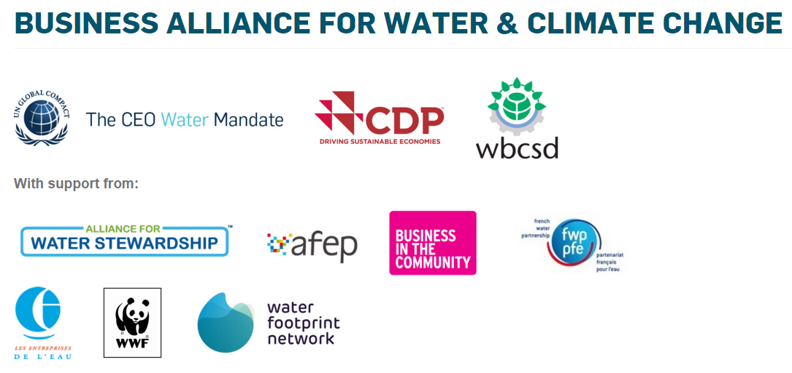

Business Alliance for Water and Climate
BAFWAC was founded by CDP, CEO Water Mandate, SUEZ and WBCSD and is part of the GCAA
The Alliance establishes a program of actions for companies focused on raising corporate ambition to address water security in support of a low carbon transition

Slide 3
Commitment expectations
By signing the BAFWAC Declaration, signatories commit to:
Regularly measure and publicly report water use data inline with internationally recognised, standardised corporate reporting mechanisms.
Analyze and report water risks and implement collaborative response strategies.
Reduce impacts on water availability and quality across the value chain.
Notes:
Analyzing and reporting water-related risks and implementing collaborative response strategies.
Level of ambition: Business are expected to commit to managing water resources based on a robust understanding as to the degree of water risks and exposure in their direct operations and value chain. Once those risks are understood, the business will develop and implement a response strategy that embeds water stewardship principles, including taking a proactive and collaborative response.
Reporting water use data (through CDP’s water questionnaire, annual sustainability reports, or your public website).
Level of ambition: CDP is the only organization collecting corporate water data; companies aren’t reporting it in their sustainability reports, and it’s not a mainstream issue yet. Thus in the realm of water, disclosure is an important step toward water stewardship. The business community must make every effort to reduce its water impact, the first step consists of measuring and reporting its water use across both its direct operations and value chain. With this information, businesses are able expected to be able to identify opportunities, manage strategic risks relating to water, implement efficient water use, optimize water management in processes and products and provide scientific, consistent and reliable information for reporting on water to stakeholders.
Reducing impacts on water availability and quality in direct operations and along the value chain.
Level of ambition: Businesses are expected to implement a strategic action plan, aimed at improving the operational eco-efficiency of water use thanks to the best available technologies, in adequacy with the local context. The plan should aim at reducing the businesses water impact, in partnership with other actors in the basin or of the value chain.
The actions required to improve water security are in many ways, different from those required to prevent climate change. Unlike carbon mitigation, improved water management is not a zero sum game. It therefore necessitates a different approach for framing corporate commitments.
The above actions were selected as the most essential foundations for meaningful corporate water action. Importantly, they also reflect those actions that have the greatest chance of uptake by the vast majority of companies as they represent a reasonable barrier to entry.

Slide 4
BAFWACs roadmap to 2018
First milestone: secure 100 corporate signatories by 2018 representing $1 trillion in revenues.
To date, more than 30 companies across 5 continents representing $680 billion in revenues have joined BAFWAC and committed to take action
We have partnered with We Mean Business through its Commit to Action campaign
to launch the first water-related commitment that will increase the number of signatories

Slide 5





























Signatories - $680 billion from 5 continents
5 I

Slide 6
BAFWACs roadmap to 2018
Second milestone: to catalyse and facilitate effective water action
Technical workshops and webinars have been held
Best practice information and dissemination platforms have been created
Monitoring and tracking of progress against commitments is underway
Collaborative action opportunity identification is underway

Slide 7
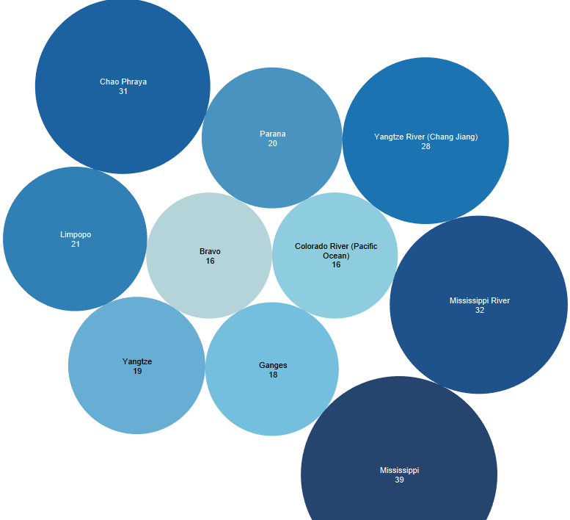
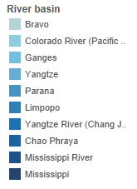

Companies reporting actions per river basin to CDP

Slide 8
Call to collaborate
We intend to host a multi-stakeholder water action workshop in a river basin of common interest to BAFWAC Signatories, The Paris Pact and Megacities Alliances
Harness the power of private sector interest in water action by hosting in a location of interest to companies.
Share information on current proposed actions to improve water security in support of a low carbon transition and identify opportunities for financing, implementing and succeeding.

Slide 9
Thank you
Contact:
Cate Lamb
Director of Programs, CDP
Cate.lamb@cdp.net l @Cate_Lamb

