Slide 1
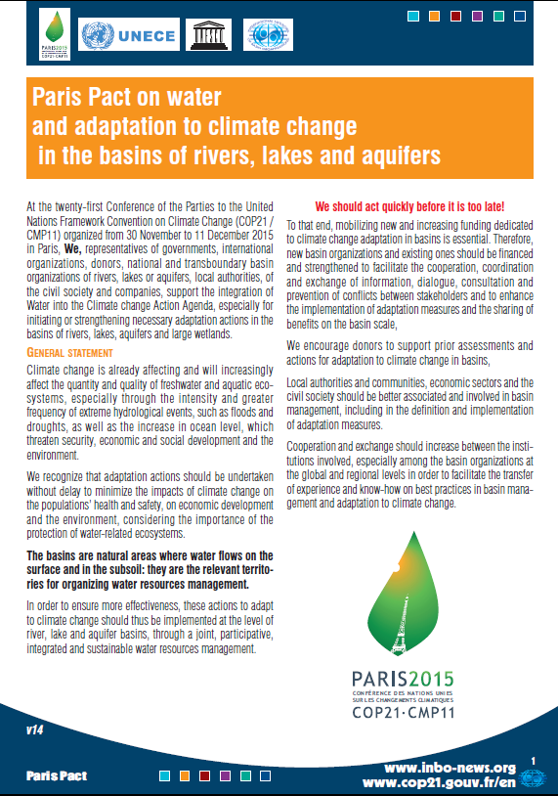




Paris Pact on water and adaptation to climate change in the basins of rivers, lakes and aquifers
From COP21 to COP22
Water : a connector for fighting against climate change
Climate Chance, 27 Sept. 2016, Nantes
Edouard Boinet
Project manager
International Network of Basin Organizations
(INBO)
Notes:
In the next few minutes, I would like first to remind you briefly of the history and content of the Paris Pact, and then to give you the latest news and perspectives about its promotion and implementation process.
The starting point of the Pact of Paris is of course the necessity to adapt water management to climate change, since the demographic, economic and ecological consequences of the climate change are likely to be very significant, and in fact have already started to affect water resources availabity in many basins

Slide 2


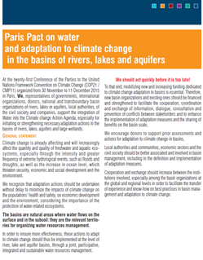
Water in official high level session of COP21:
The Lima-Paris Action Agenda (LPAA) 1/2
Lima-Paris Action Agenda (LPAA) :
Joint initiative (French & Peruvian presidencies of the COP20 & COP21, Executive Office of the Secretary-General of the United Nations, Secretariat of the UNFCCC) aiming at the development of climate actions (mitigation/adaptation) by civil society actors.
Many commitments have been presented during the half-day of the LPAA dedicated to water (2nd December 2015):
  Launch of the Business Alliance for Water & Climate Change (40 companies committed to reduce the water footprint of their industrial processes),
  Launch of the Megacities Alliance for Water and Climate (10 cities, 85 million people)
  Launch of an awareness-raising campaign on the link between water & climate issues by 20 youth associations,
  Launch of the Paris Pact on water and adaptation in basins.
Notes:
The Paris Pact was originally promoted by INBO, together with UNECE, and was following previous work about the concrete actions experimented in many basins, and that had been collected and presented in our Handbook issued in 2015 about “water and climate change : adaptation in transboundary basins, about the lessons learned and the good practices collected. A very good report that I encourage you to read !

Slide 3
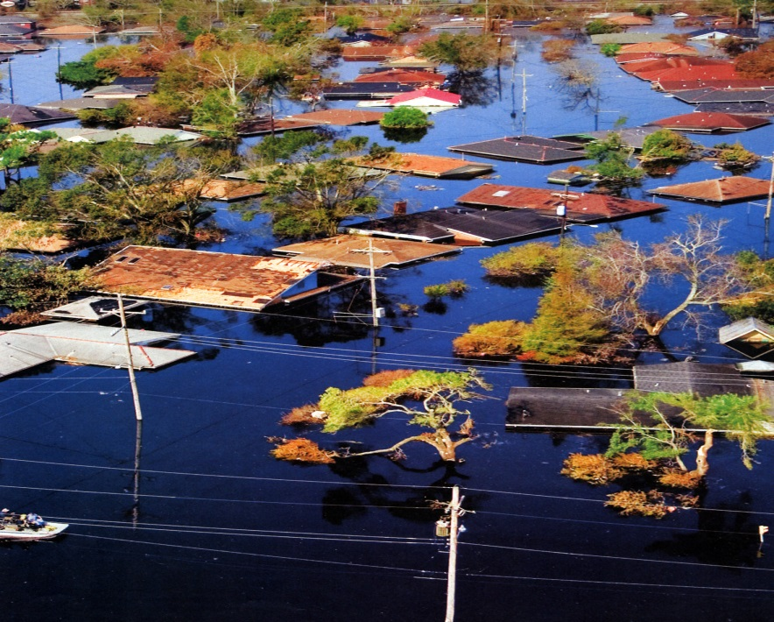
A new step towards action
National/
transboundary basin organizations
Governments
Local authorities
Civil society
Private companies
Donors
International organizations
Notes:
The content and purpose of the Pact of Paris are very simple : create a mobilization for action, from all the stakeholders in the basins, in order to enhance and to accelerate strategies and measure plans better adapted to the current and future effects of climate change for Integrated Water Resources Management in the basins.
That is the reason why the Pact of Paris re-insisted on the necessary awareness and commitment of all stakeholders involved in water management, because climate change will result in the increase of extreme events, the modification of usual hydrological values and levels, but also in an increased uncertainty towards hydrometeorological phenomena.
Every kind of stakeholder can be mobilized : governments, international organizations, donors, national and transboundary basin organizations of rivers, lakes or aquifers, local authorities, represnetatives of the civil society and private companies.

Slide 4
4 priority commitments in the Pact of Paris
Reinforce capacity development and knowledge
Monitoring networks (meteorology, hydrology, quality, uses, environment…)
Exchange platforms between research and decision making
Adapt basin management planning
Impact and vulnerability assessment
Production of adpatation strategies
Reinforce governance
Individual capacities of BO staff (training)
Institutional capacities (sharing experiences)
Ensure adequate financing
Sustainable financial mechanisms
Polluter/consumer pays principles
Investment programs
Cost-effectiveness analysis
Financial support by donors
Integration with related sectors (agriculture, energy, transport, tourism, fish farming…)
Stakeholders participation
Water Information Systems
Data interpretation capacities
Translation into policy responses
Floods and droughts prevention actions
Performance indicators
Water demand control for agricultural, industrial and municipal uses
Development of water supply
Water-related ecosystems services (NWRM)
Notes:
Nothing really new about the principles, but a strong focus on necessary action, because it’s rather urgent now !
4 priority commitments were chosen, including very operational implementation topics
The framework for action is already well-known, and, once again, we are used to summarize it under the “basin IWRM” vocabulary. It is time to really implement these principles, to adapt them to each context of CC adaptation needs…

Slide 5
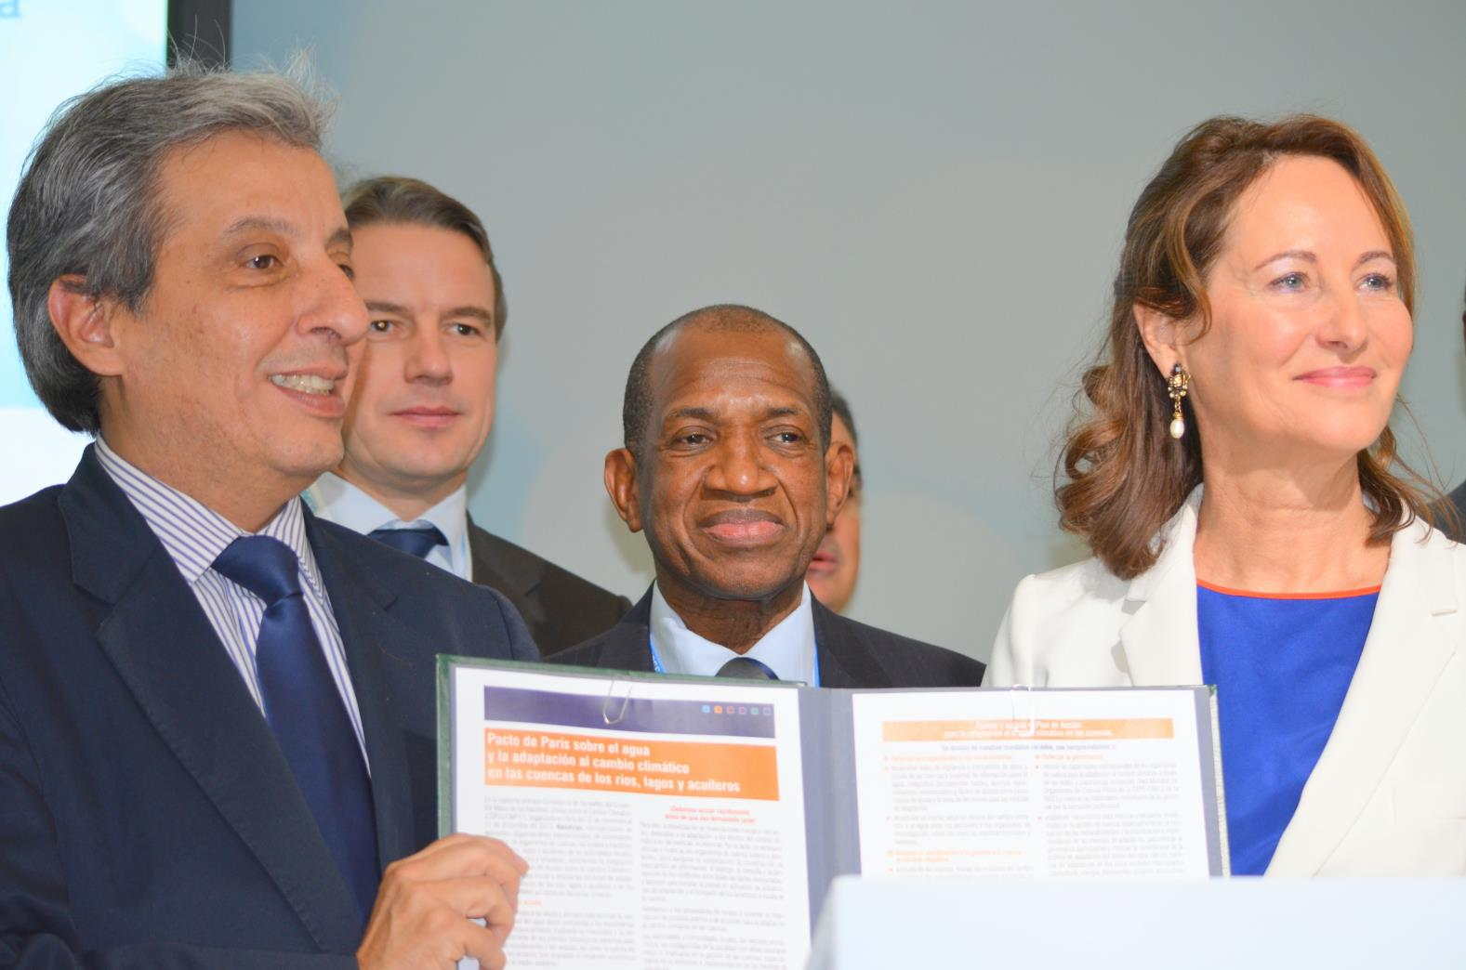
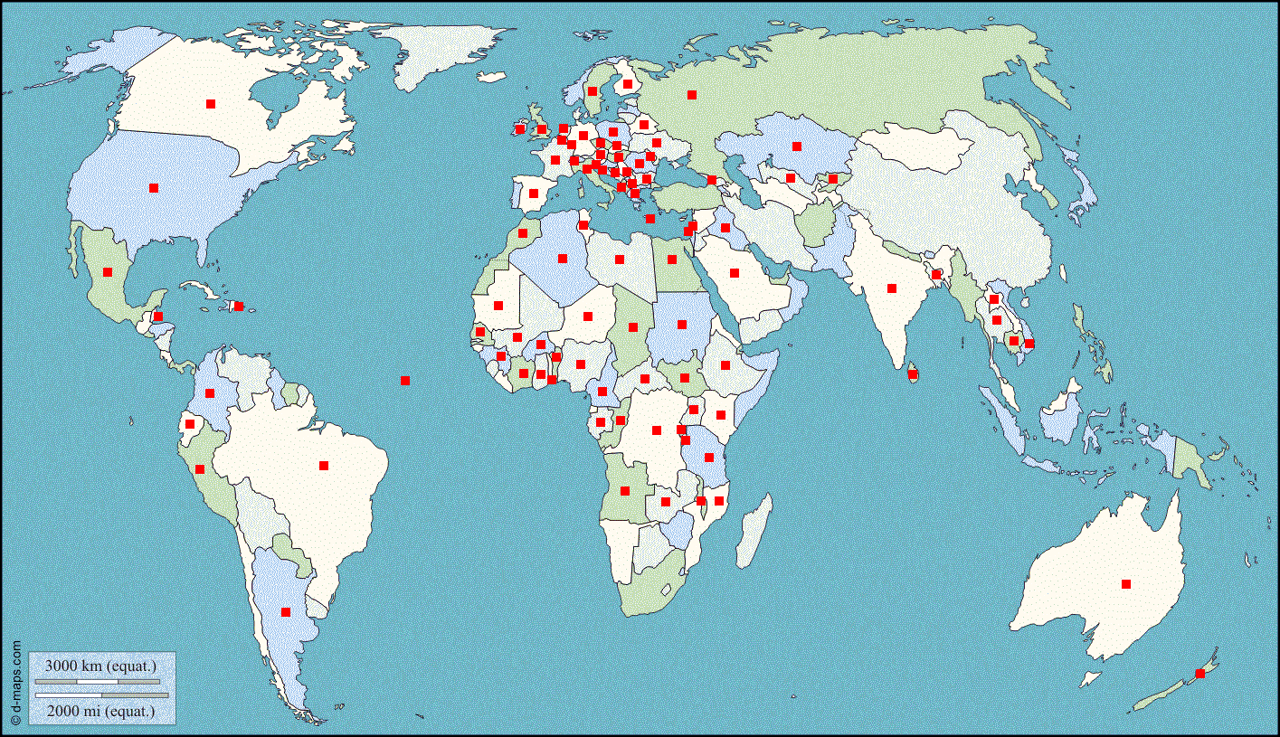
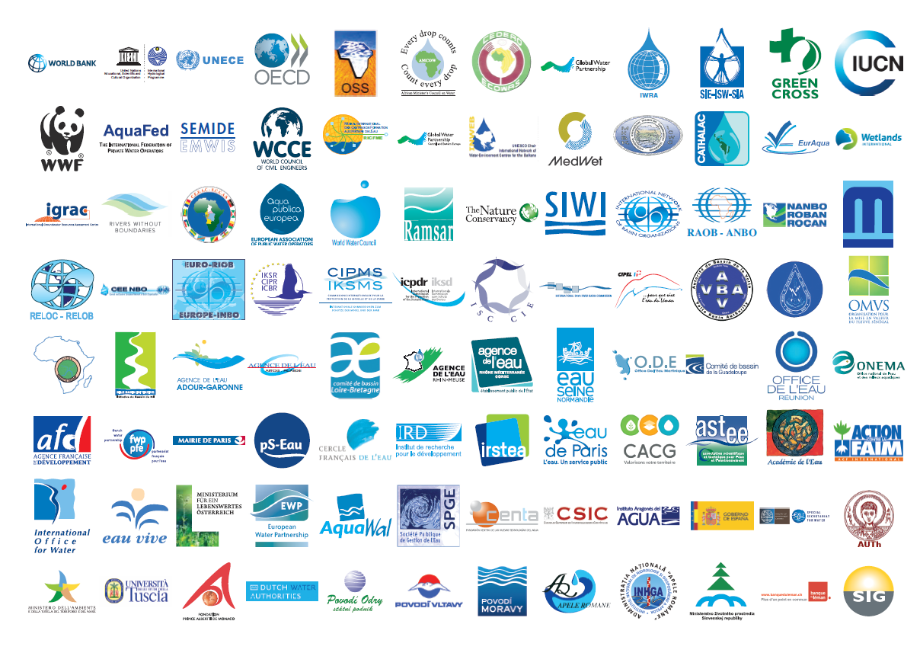
Water in official high level session of COP21:
The Lima-Paris Action Agenda (LPAA)
Paris Pact on water and adaptation to the effects of climate change in the basins of lakes, rivers and aquifers (INBO initiative):
  350 organizations from 94 countries
  Among the signatories on the 2nd December: 4 Ministers in charge of water management (Bénin, France , Morocco, Peru) and the Executive Secretary of the United Nations Economic Commission for Europe (UNECE)
Notes:
The Paris Pact has been strongly supported by the governments of Peru and France, as part of the Lima Paris Action Agenda, and has been officially approved and signed during COP21 in Paris.
Together with the presentation of the Pact, a first list of flagship projects was presented, with speakers have showcasing concrete examples of commitments taken under the framework of the Paris Pact: Projects of IWRM for adaptation in basins of South America (EcoCuencas project: Brazil, Colombia, Ecuador, Peru), Africa (OMVS, NBA, CICOS), Mexico (Valley of Mexico), China (Hai river basin, incl. Beijing & Tianjin) and in aquifers (India)

Slide 6

From COP21 to COP22 : Strengthening and mobilizing
the Paris Pact community
Milestones for the promotion & follow-up of the Paris Pact:
  3rd meeting of the global network of basins working on climate change adaptation, Geneva, 6-7 April 2016,
  10th World General Assembly of the INBO, Merida, 1-4 June,
  OECD 7th meeting of Water Governance Initiative, 23-24 June
  “Water Security for Climate Justice”, Rabat, 11-12 July,
  6th Global Workshop on water and climate in transboundary basins (UNECE/INBO & al), Geneva, 13-14 September,
  COP22, Marrakech, 7-18 November.
Paris Pact 2016 Call for Action :
  Calling for new signatories ,
  Calling for new commitments
  Thematic focus of Paris Pact 2016 Call for Action:
    Monitoring networks (meteorology, climatology, hydrology, water and ecosystem quality, water uses including withdrawals and pollutant discharges, environment and biodiversity),
    Water Information systems (data collection, management and sharing).
Notes:
We’ve been trying to keep a very busy agenda for paris Pact.
Follow-up: the global network of basins working on climate change adaptation (jointly managed by UNECE & INBO) is in charge of the follow-up of these commitments as well as of the promotion of the Paris Pact.
And I would really like to insist on the importance of WIS, as the key toolkit in the basins for building dialogue on facts, for enabling wise decision making processes, for sharing relevant information.

Slide 7
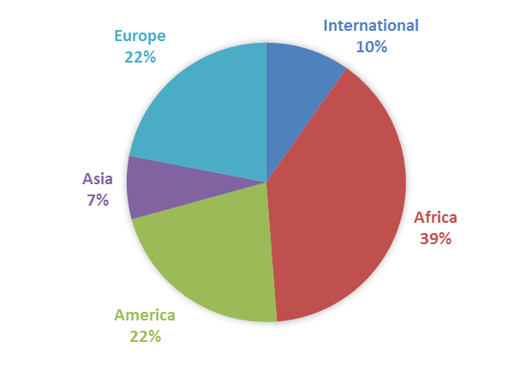
Paris Pact projects : geography
Notes:
First message : main origin of the projects in Africa, which means something about the level of concern in these countries, good représentation of Europe and America, but very few returns from Asia. The coming governance should work on that.

Slide 8
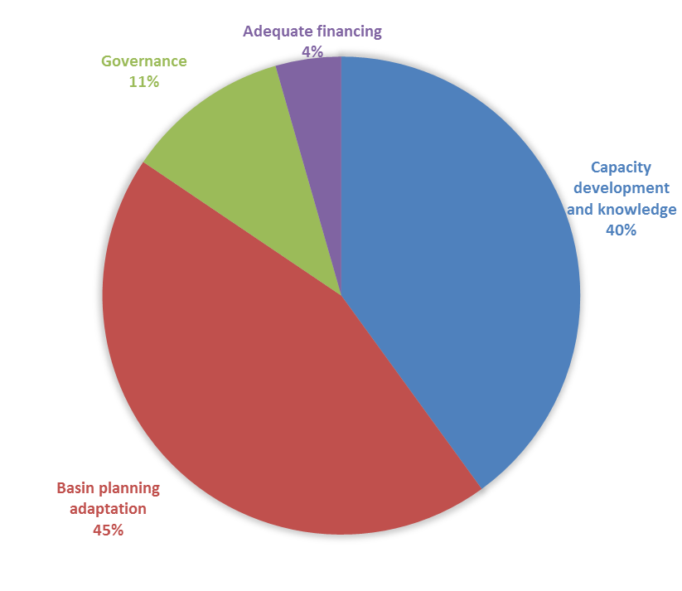
Paris Pact projects : topics
Notes:
Very low amount of projects concerning sustainable funding mechanisms : it’s a key issue. How can we foster the commitments of donors and financial institutions in the implementation of the Pact ?

Slide 9
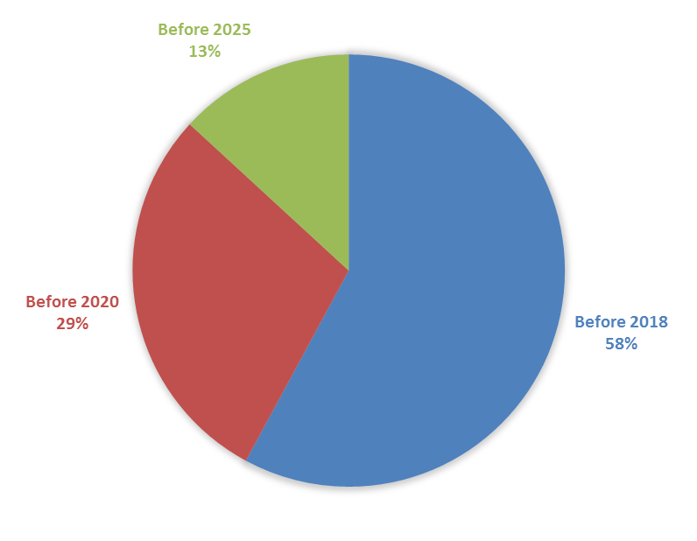
Paris Pact projects : time repartition
Notes:
A majority of the projects are « short term » projects : that’s a positive sign demonstrating the mobilization. But how do me maintain the momentum ? Generate new projects ?

Slide 10
Next steps
Keep a high profile for water in the climate debate
  For the Paris Pact (expand the Paris Pact community and its projects)
  For the COP in general (securing a place for water)
Make projects happen
  The dramatic lack of relevant Water Information Systems in many basins (linkages with CREWS & co.)
  The necessity to improve the dialogue between projects holders and funding organizations
    Towards a project incubation/acceleration platform ?
    Towards a long-term political governance ?
Structuring water Alliances within the Global Climate Action Agenda…
Notes:
Dynamize, catalyse…

Slide 11
THANK YOU FOR YOUR ATTENTION !
Still time to sign in !
International Network of Basin Organizations
Réseau International des Organismes de Bassin
www.inbo-news.org
International Office for Water
Office International de l’eau
www.iowater.org
e.boinet@@inbo-news.org

