Slide 1

WATER AND CLIMATE
FORUM
27 sept. 2016 – Nantes, France

Slide 2
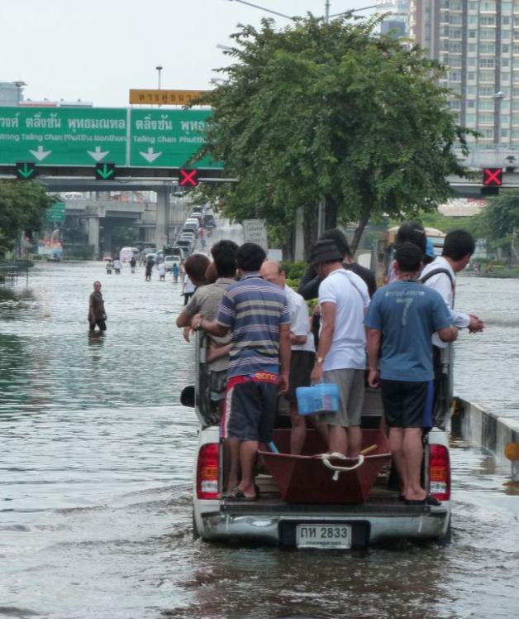
Climate is Water
“Water and its availability and quality will be the main pressures on, and issues for, societies and the environment under climate ”(IPCC)
Since the Rio Earth Summit in 1992 floods, droughts and storms have affected 4.2 billion people and caused USD 1.3 trillion of damage
Floods, droughts and windstorms are the most frequently occurring natural disaster events and account for almost 90% of the 1,000 most disastrous events since 1990

Slide 3
Climate and Water - Major Challenges
Risks; World Economic Forum Global Risk Report 2016: Water Crises is the risk of greatest concern over the next 10 years
Demand; By 2050, global water demand is expected to increase by 55 per cent (OECD Environmental Outcome)
Shared waters; Over 50 % of available freshwater resources are in shared river basins
Water and cities By 2030, 60 % of the worlds population will live in urban areas
Access to water and sanitation: Almost 2 billion lack access to SAFE water. Almost 2,5 billion lack access to adequate sanitation
Pollution of ecosystems: 80 per cent of wastewater globally is discharged untreated

Slide 4
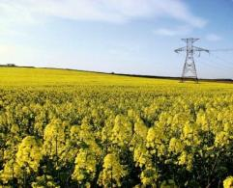
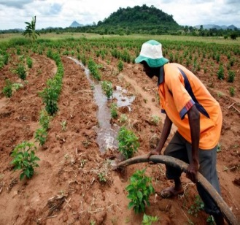
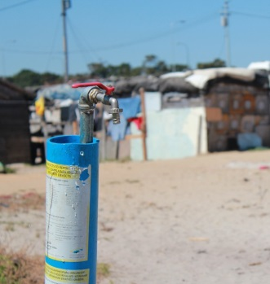
Water provides an excellent link for a coherent approach
Supporting adaptation for increased resilience means to minimize water hazards and maximize water sustainability and efficiency
Access to water is crucial for energy production where future energy solutions and choices will have implications on water availability for other sectors.
In 2013 about a third of the worlds cities obtained a significant portion of their drinking water directly from forested watersheds and protected areas

Slide 5
We must act together!
Non-state actors are important in contributing to combat Climate Change
The water community can provide solutions and water can help linking between different areas and briding between policy and practice
We need to interact with the formal UNFCCC processes – how can we do that in a good way?

Slide 6
Part 1 – The Paris Agreement and the mobilization of non-state actors for water and climate: current alliances and other initiatives
Part 2 – Raise the ambition of the Paris Agreement: the roadmap of non-state actors for water and climate
Conclusion and perspectives

Slide 7
Part 1 – The Paris Agreement and the mobilization of non-state actors for water and climate: current alliances and other initiatives
The “Paris Pact on water and adaptation to the effects of climate change in the basins of lakes, rivers and aquifers” : Edouard Boinet, International Network of Basin Organizations (INBO)
The Business Alliance for Water and Climate Change : Cate Lamb, CDP
The Megacities Alliance on Water under Climate Change : Jean Didier Berthault, Syndicat Interdépartemental pour l’Assainissement de l’Agglomération Parisienne (SIAAP)
Youth initiative : Vilma Chanta, Central America Youth Water Network, GWP regional youth focal point
NGOs’ initiatives : Virginie Bineau, Eau Vive / Butterfly Effect

Slide 8
Part 2 – Raise the ambition of the Paris Agreement: the roadmap of non-state actors for water and climate
Presentation of the coalition, objectives, governance : Philippe Guettier, French Water Partnership / ClimateIsWater
Our strategic priorities :
Kristel Malègue, Coalition Eau ; Hélène Valade, Suez
Mobilization of new actors and complementary strategic actions (discussion with the audience)

Slide 9
Conclusion and perspectives:
Jean Marie Tétart, French Water Partnership
Tom Soo, World Water Council / ClimateIsWater

Slide 10
Thank you for your attention
and your participation

