Slide 1

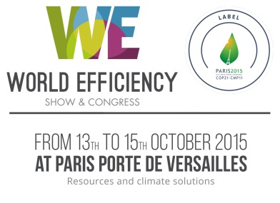


“Responding to the Challenges of Water Security”
International Hydrological Programme
PHASE VIII, 2014-2021
Dr Anil Mishra
International Hydrological Programme (IHP), UNESCO
Plenary: Water and Climate: The French Approach.
Wednesday 14 October, 10.30-12.30

Slide 2
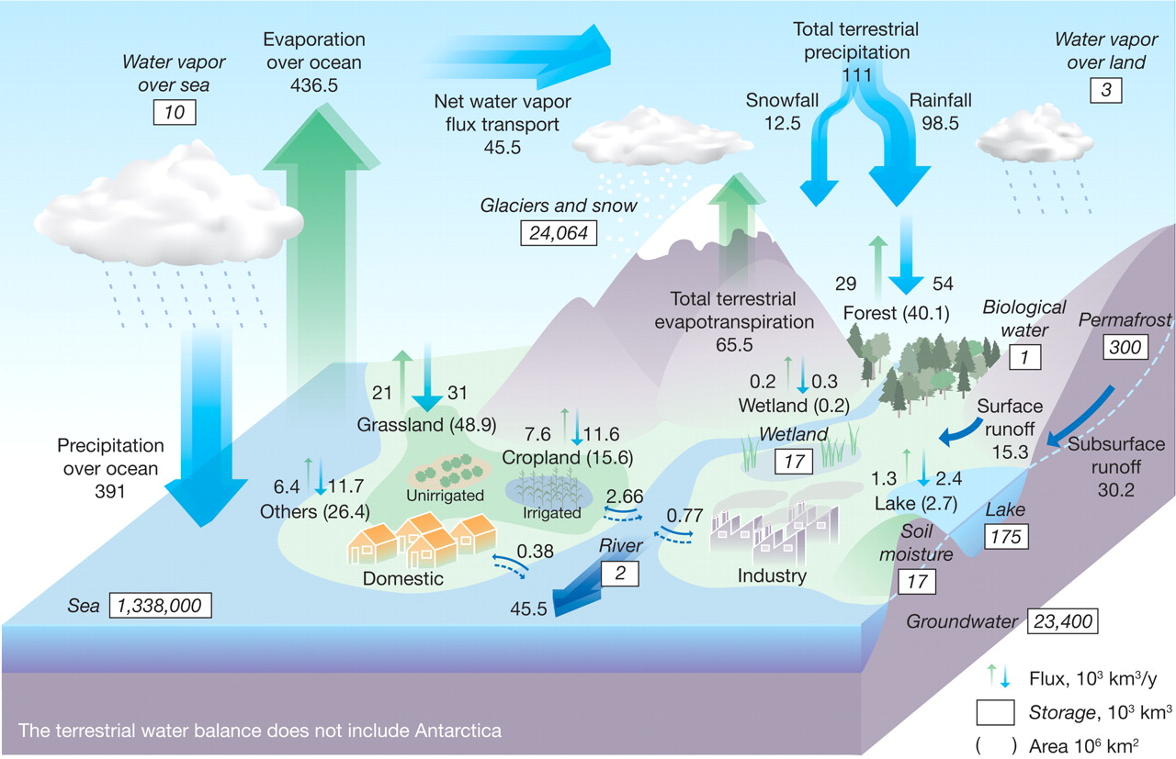
Global Hydrologic Cycle
Source: Oki and Kanae 2006 Science
Notes:
If there is a water crisis, it is not because we are at the limit globally - order of magnitude – all the rivers of the world discharge 45.5 x 10^3 cubic kilometers of water – whereas humans use 9 x 10^3 cubic kilometers (or 20%) – the problem is with the distribution in time and space, accessibility and quality.
2

Slide 3

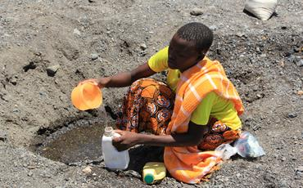
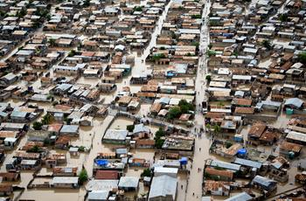
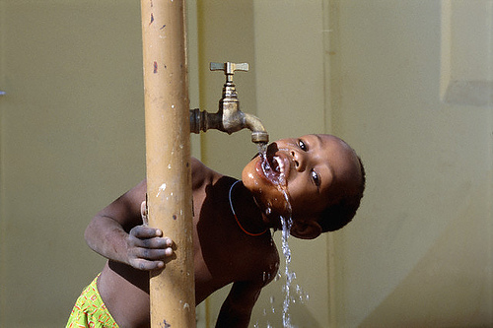
Water Security: 21st Century key challenges
85% of the human population live in arid areas. By 2030, half of the population will be living in areas of high water stress.
6-8 million human beings are killed each year from water‐related disasters and diseases.
750 million people lack access to safe water and 2.5 billion to adequate sanitation.

Slide 4
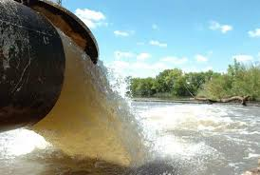
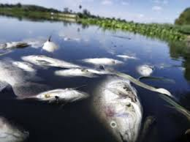
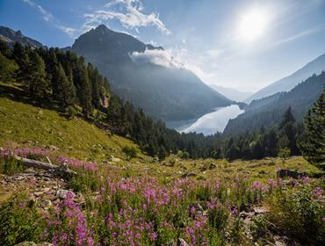
Water Security: 21st Century key challenges
Almost 85% of the world’s total wastewater is discharged without adequate or any treatment.
In just thirty years, populations of freshwater species declined by 50%
145 nations have transboundary river basins and there are 445 transboundary aquifers shared by 2-4 countries

Slide 5

Economic losses caused by floods and droughts have been on the rise. They are higher, in absolute terms, in developed countries, while fatality rates and relative economic losses expressed as a proportion of GDP are higher in developing countries. This has grave security implications.
From 1970-2008, over 95% of natural-disaster-related deaths occurred in
developing countries. Source: IPCC SREX
Kundzewicz, 2014
Notes:
HIGH CONFIDENCE
SPM: Page 4, line 26-27
Report: 4.5.2
Page 40: During the 25 year period from 1970 to 2008 over 95% of deaths
from natural disasters occurred in developing countries and direct economic losses averaged US$54 billion per
annum (Freeman, 2000; Cavallo and Noy, 2010).
Cavallo, E. and I. Noy, 2010: The economic of natural disasters: A survey. Inter-American Development Bank, IDB
Working Paper Series, No. IDB-WP-124 International Monetary Fund WP/04/224,
http://www.iadb.org/res/publications/pubfiles/pubIDB-WP-124.pdf
5

Slide 6
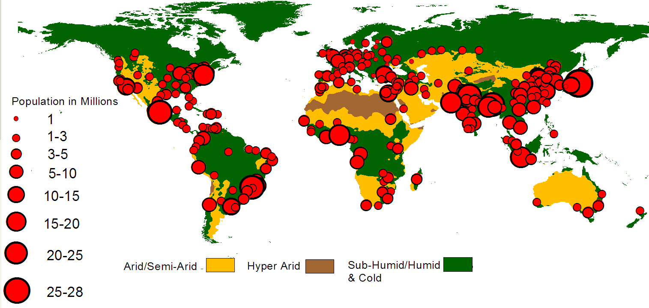
Increasing Population: Number of Mega Cities
Projected Global Population: 8.3 Billion by 2025
By Soroosh Sorooshian, UCI
Notes:
6

Slide 7
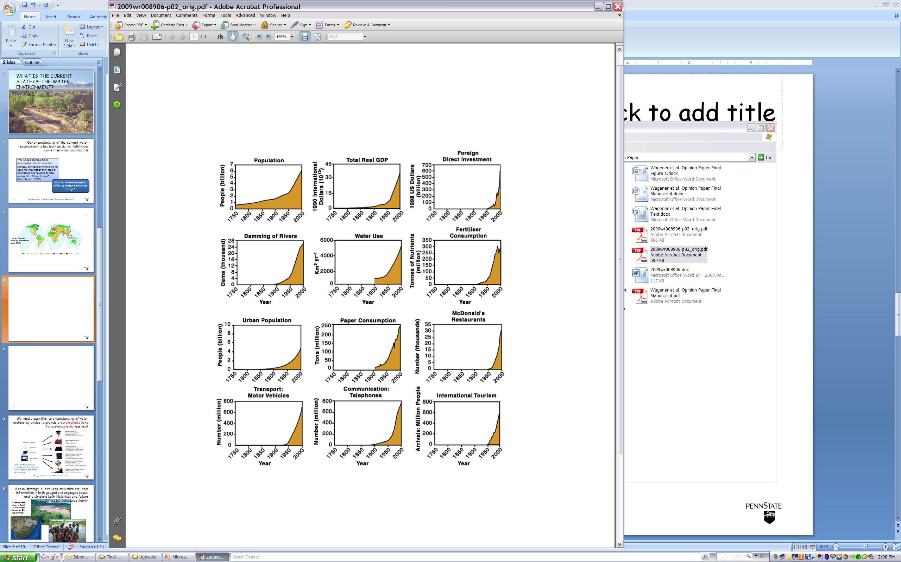
Human activity has increased dramatically over the last 60 years
Human activity now rivals geologic‐scale forces (Kieffer, 2009), with a footprint that is deepening and widening rapidly across the planet.
Notes:
Dealing with change is the biggest problem with water management – the biggest change is the role of humans (many of you have seen this in the Millennium Assessment Reports) – the telling quote is by Sue Kieffer (a geologist) who makes the claim that the human activity now rivals geologic-scale forces.

Slide 8

Nearly 80% of the world’s population is exposed
to high levels of threat to water security
Vörösmarty et al., 2010

Slide 9
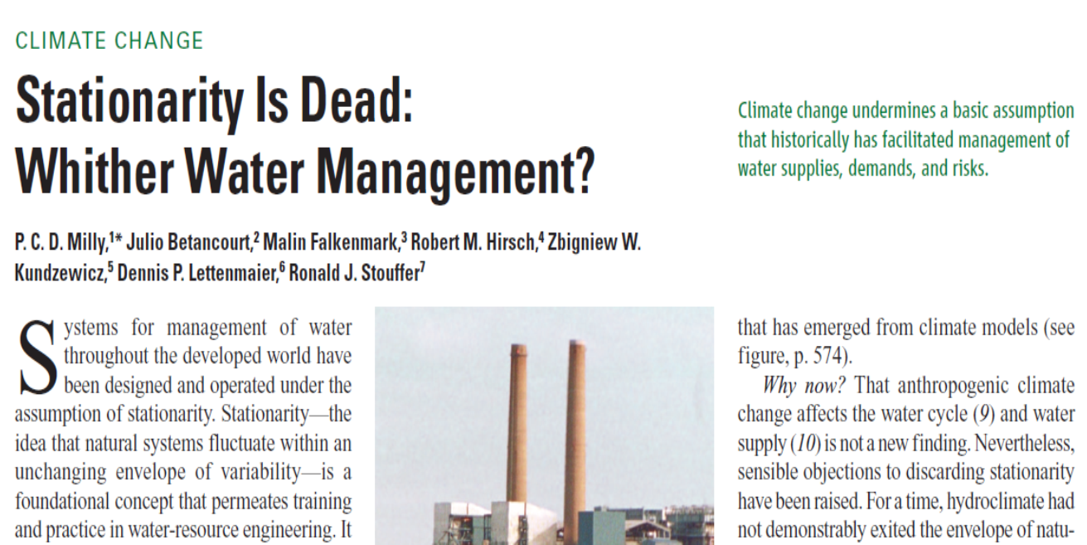

Slide 10
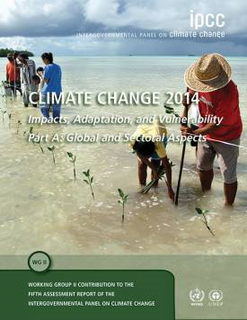
IPCC Fifth Assessment Report
IPCC Fifth Assessment Report – Working group II
Climate change 2014: Impacts, adaptation, and vulnerability
Chapter 3: Freshwater Resources

Slide 11

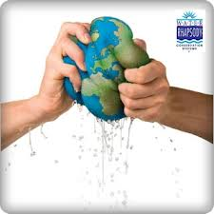
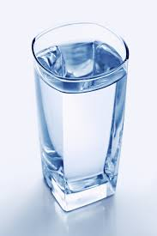
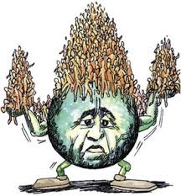
AR5 IPCC (2014) Key risks at the global scale
General:
Freshwater-related risks increase significantly with increasing greenhouse gas emissions
  Each degree of warming is projected to decrease renewable water resources by at least 20% for an additional 7% of the global population.
  Climate change over the 21st century is projected to reduce renewable surface water and groundwater resources significantly in most dry subtropical regions , intensifying competition for water among sectors.
7% of global Population
1ºC = 20%↓

Slide 12
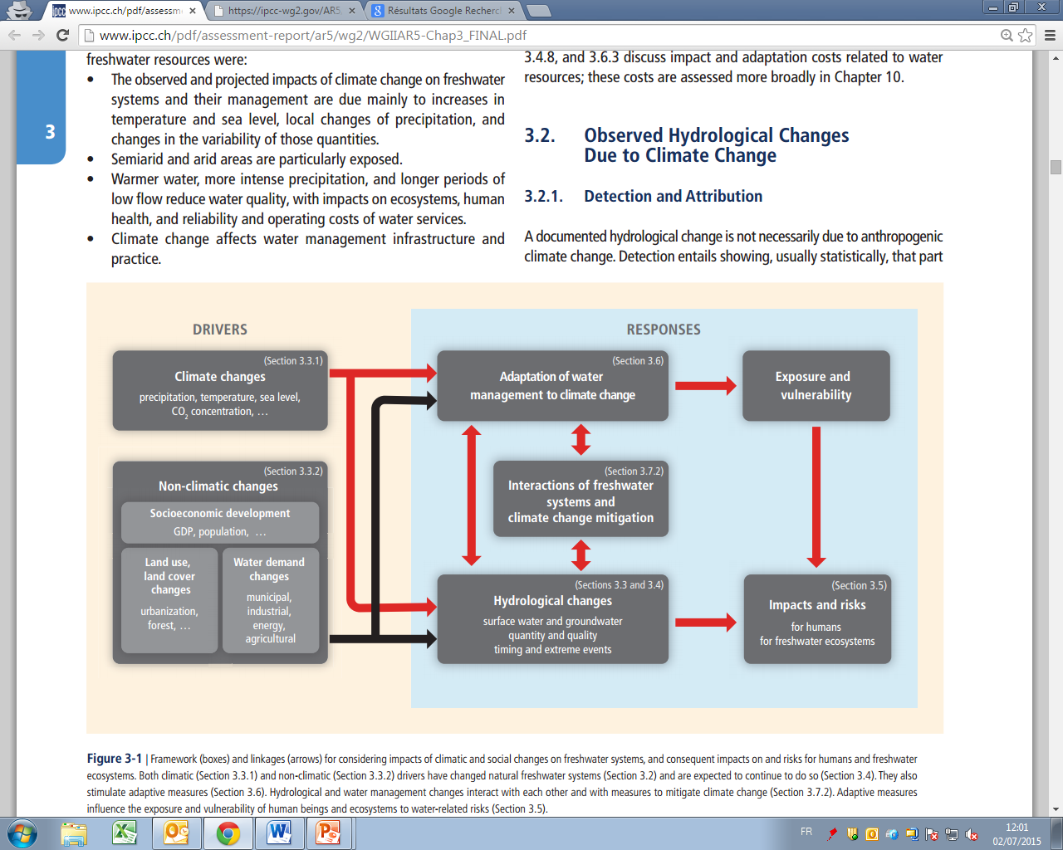
IPCC Fifth Assessment: Climate change impacts
Risks and impacts

Slide 13
IPCC Fifth Assessment: Climate change impacts

Slide 14
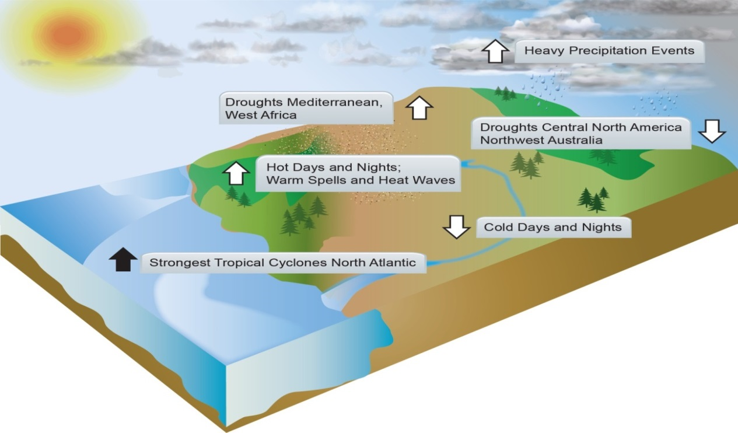
IPCC Fifth Assessment: Chapter 3 Freshwater Resources
Projected hydrological changes:
Evapotranspiration, soil moisture and permafrost
Glaciers
Run-off and streamflow
Groundwater
Soil erosion and sediment load
Water quality
Floods and droughts

Slide 15
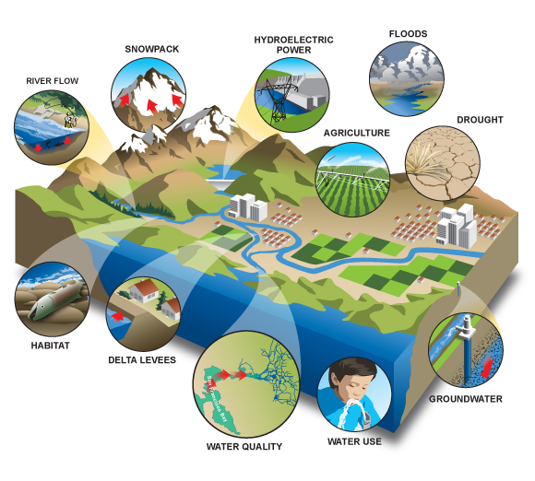
IPCC Fifth Assessment: Freshwater Resources
How will the availability of water resources be affected by climate change?
Agriculture
Energy production
Municipal services
Freshwater ecosystems
Various other uses

Slide 16
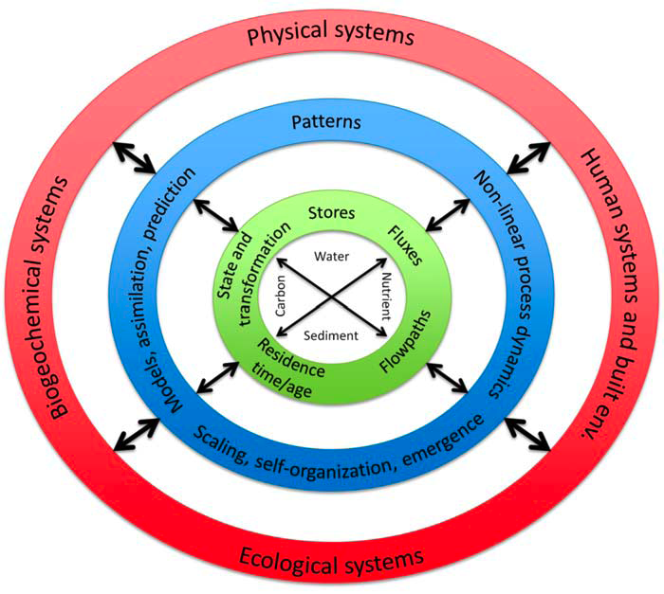
Hydrology is not just the study of water!!!
Earth System Science. Only integrated frameworks that embed humans explicitly will enable us to manage water cycle dynamics to prevent or solve the water crisis.
Shivapalan, 2010
Notes:
Clearly, this is a complex system, that makes hydrology a key part of earth system science. Clearly only an integrated framework that embraces physical, biogeochemical, ecological and especially human subsystems is needed to address the global water management crisis.

Slide 17
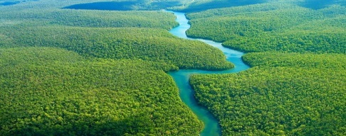
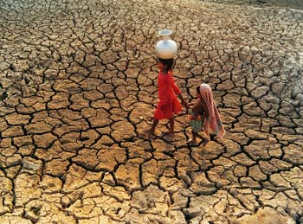
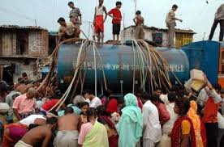
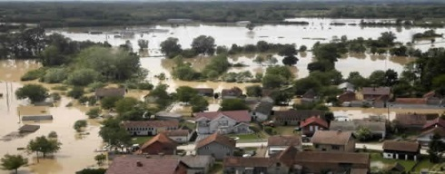
IPCC Fifth Assessment: Adaptation and Managing Risks
How should water management be modified in the face of climate change?
Long-term planning (over several decades) is needed for a future that is highly uncertain
A flexible portfolio of solutions that produces benefits regardless of the impacts of climate change (“low-regret” solutions) and that can be implemented adaptively
Policy approaches for adaptation and mitigation, technology and finance International cooperation
Policy linkages among regional, national, and sub-national climate policies offer potential climate change mitigation benefits
Policies to evolve progressively, thus building on—rather than losing the value of—previous investments
Restoring and protecting freshwater habitats
Adaptive measures

Slide 18
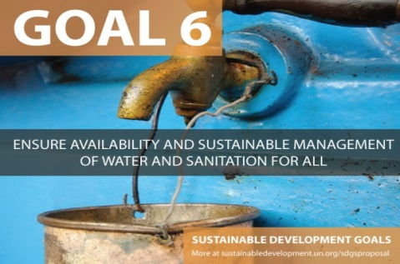
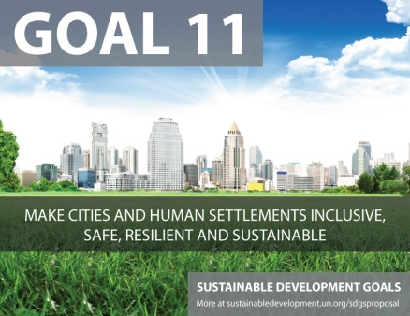
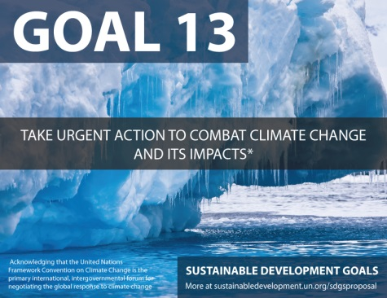
Delivering responses: IHP-VIII (2014-2021)
IHP-VIII (2014-2021):
Water security: Responses to local, regional and global challenges
IPCC’s Fifth Assessment Report WG-2 on Impacts, Adaptation and Vulnerability (AR5) 2014: Risks and Challenges
IHP contributing to SDGs mainly :

Slide 19
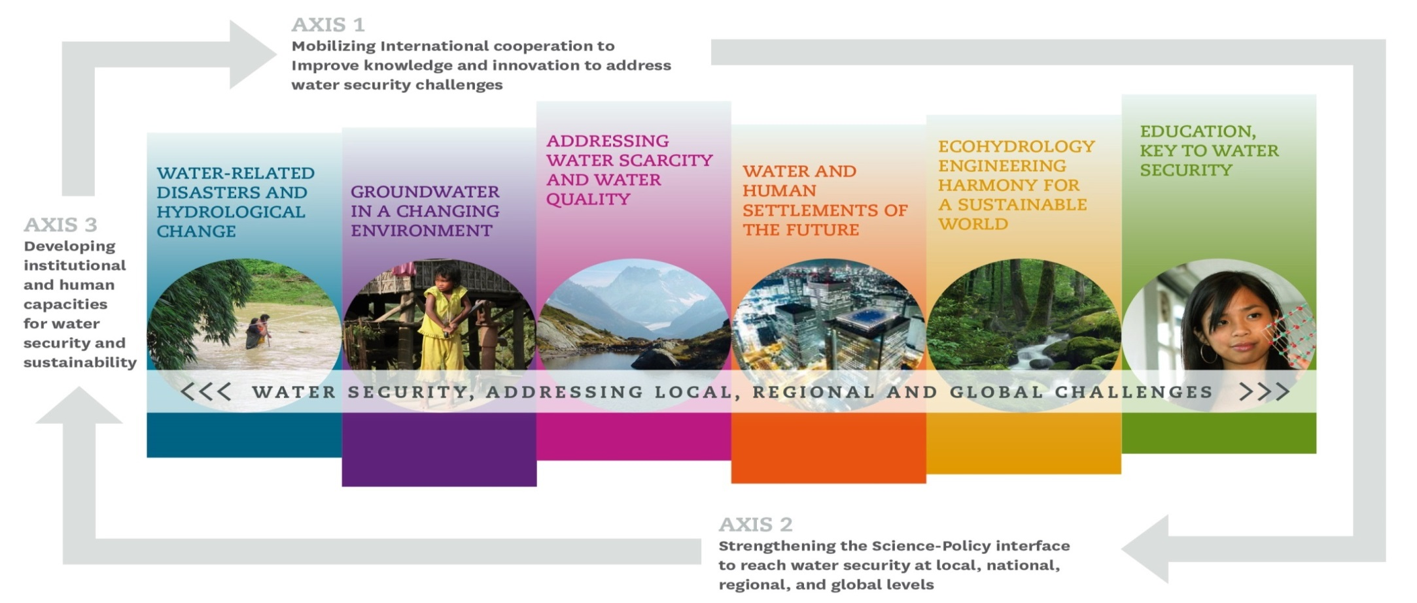
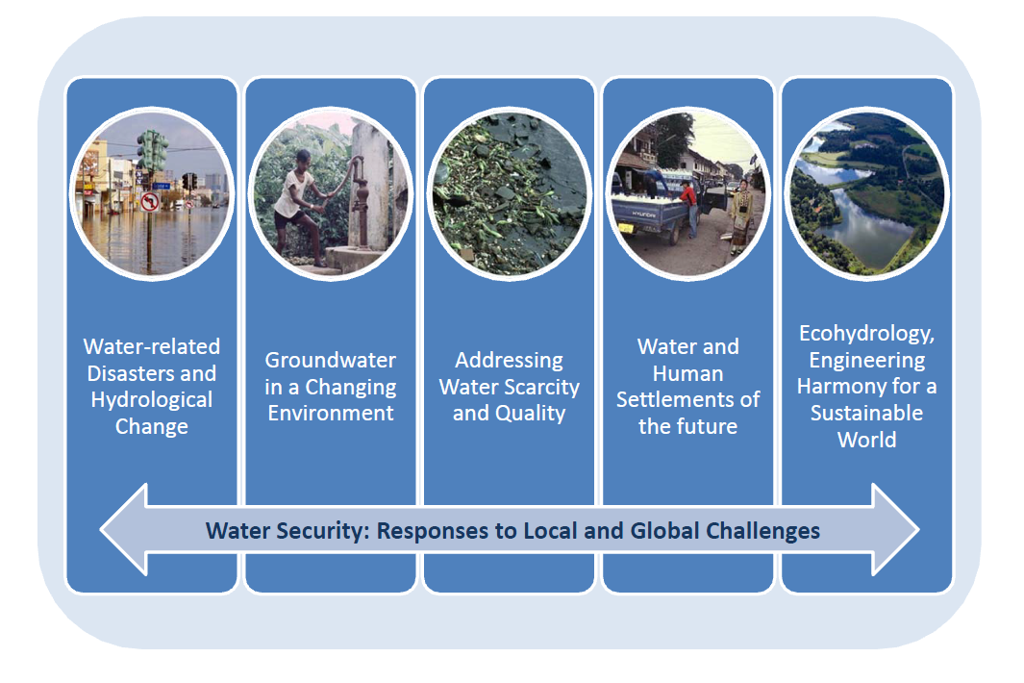
IHP-VIII Responses: 6 Themes, 3 Axes 2014-2021
Axis Improve knowledge and innovation to address water security challenges
Axis 3: Enhancing policy advice to reach water security at local, national, regional and global levels.

Slide 20
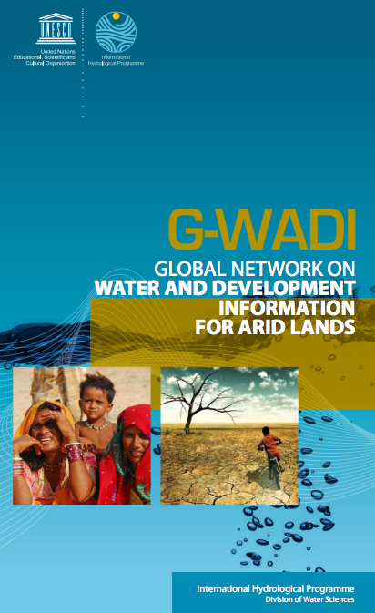
G-WADI
Improved understanding of the characteristics of hydrological systems and water management needs in arid areas
Capacity building of individuals and institutions
Broad dissemination of information to the user community and the public
Exchange of experience
Promoting integrated basin management and the development and use of appropriate decision support tools.

Slide 21
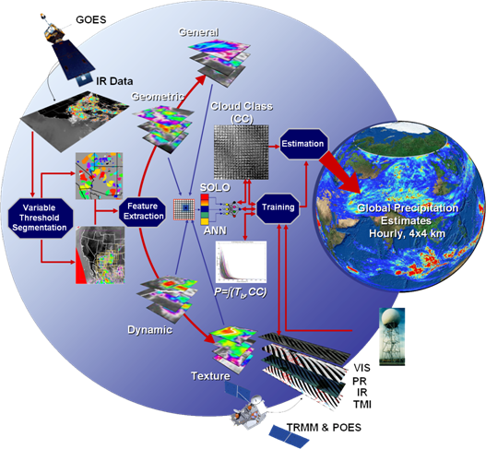
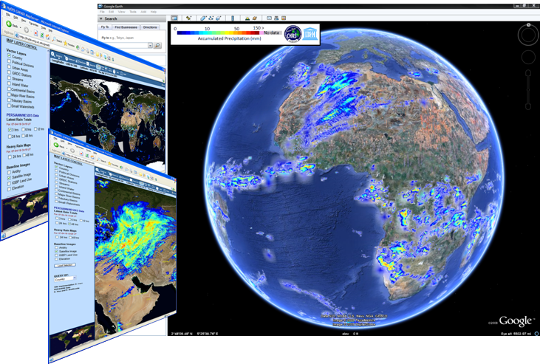
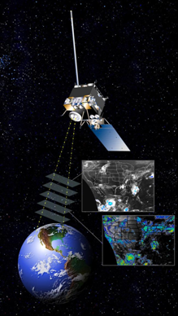
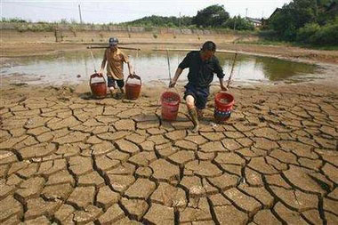
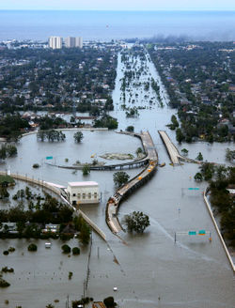
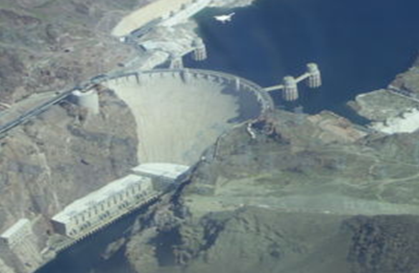



G-WADI Geo-Server
Algorithm
Web Services
Web Services
Applications
Applications
Drought Management
Flood Forecasting
Water Resources
Center for Hydrometeorology & Remote Sensing, University of California, Irvine
Notes:
21

Slide 22
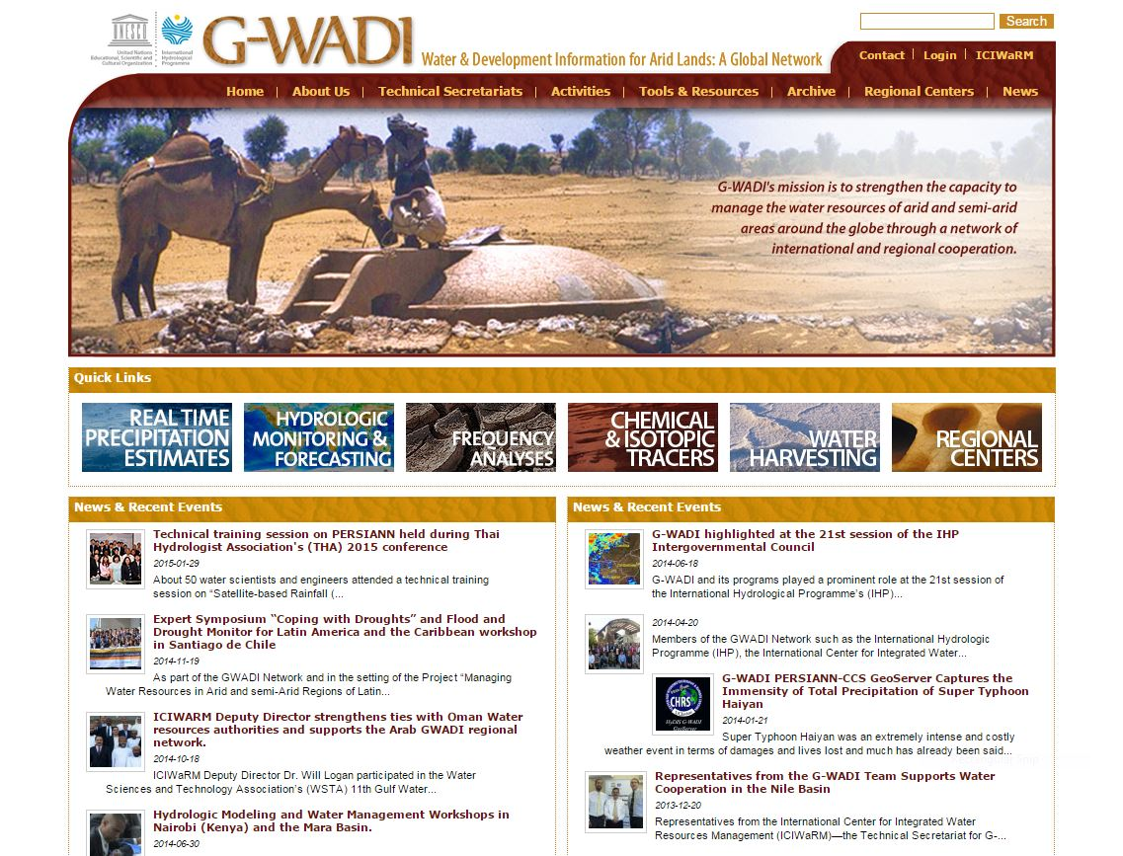
G-WADI Website
http://www.gwadi.org/

Slide 23
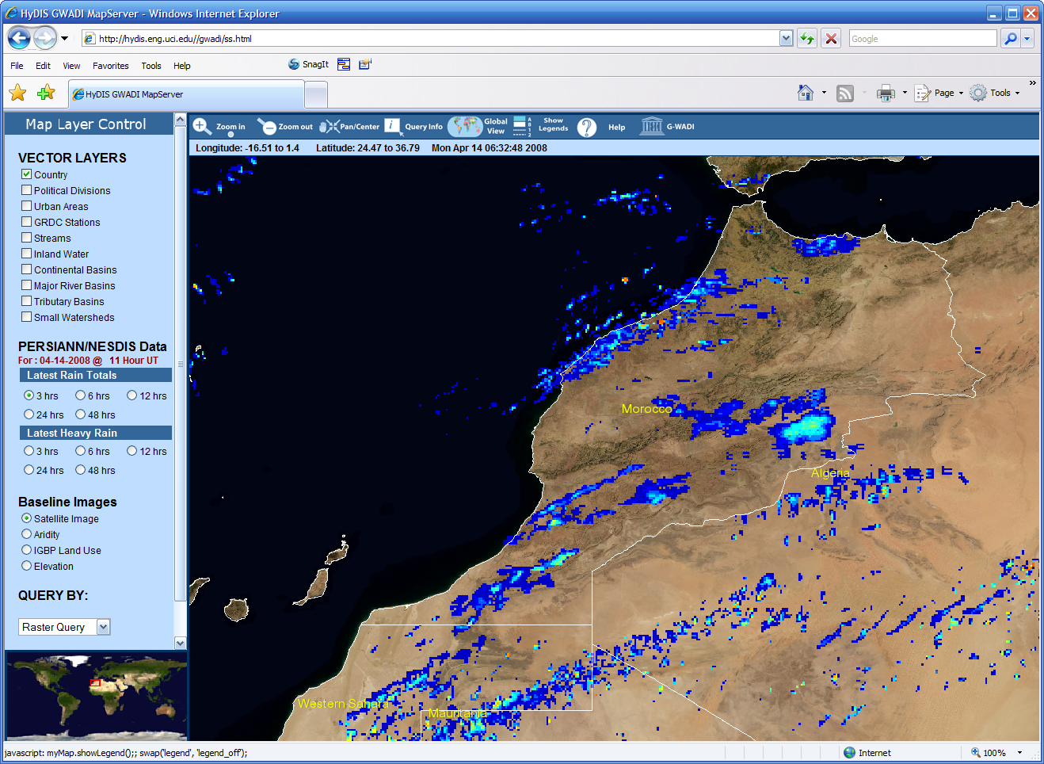
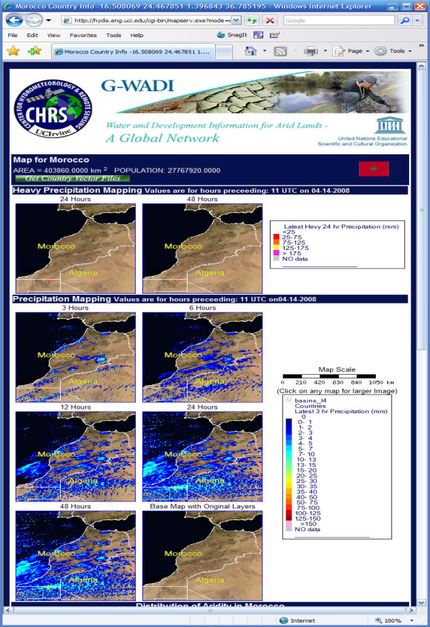
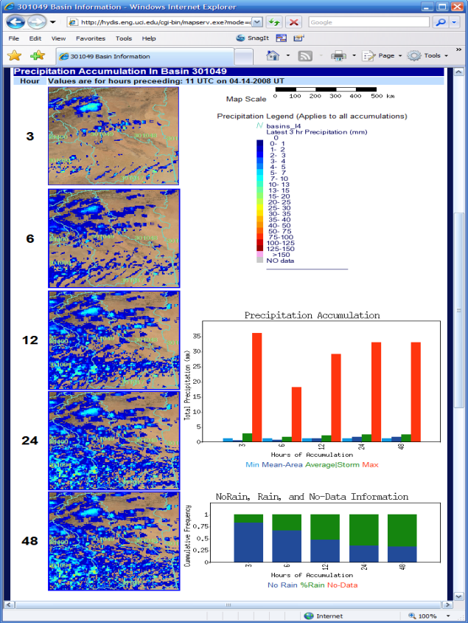
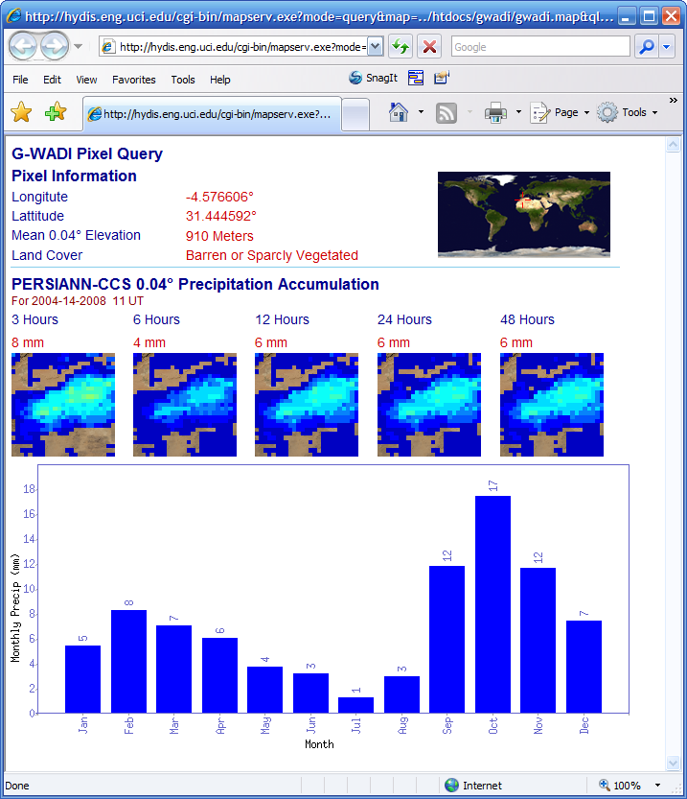
UNESCO G-WADI Geoserver, at UCI
Zooming to any area
of the world
Country Report
Watershed Report
Rainfall amounts
at any point on the globe

Slide 24
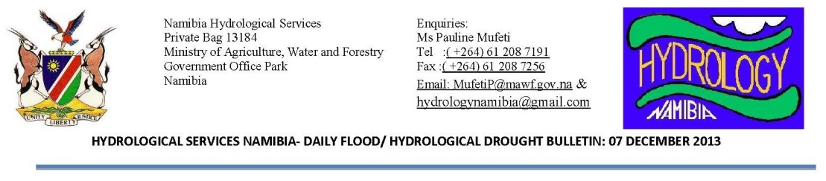
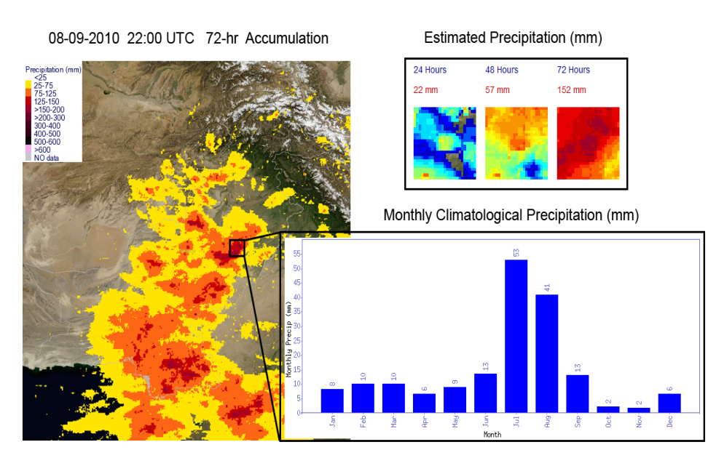
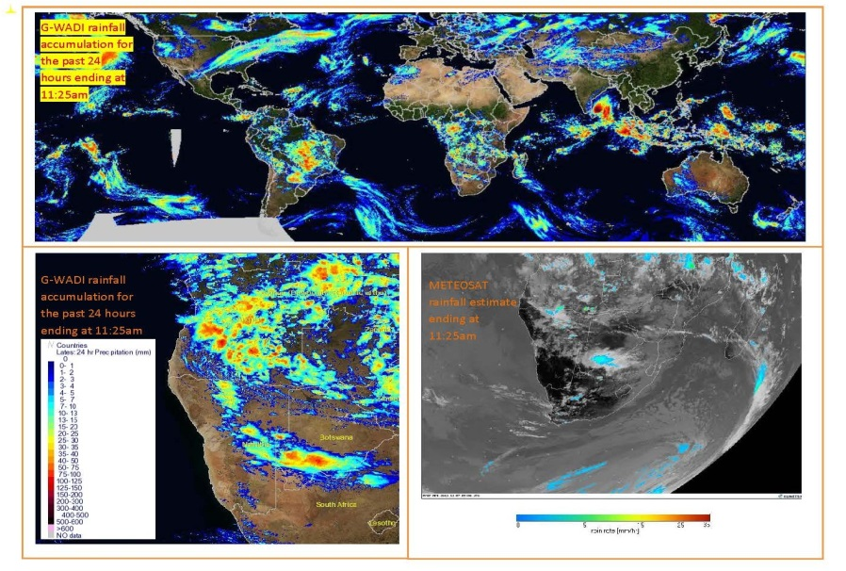
G-WADI geoserver application in Namibia and Pakistan

Slide 25




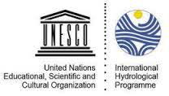
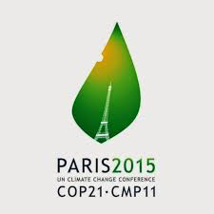
2015: SDG, COP-21, Water Forum, DRR
COP21 Paris, France, December, 2015
3rd World DRR conference Sendai
March
7th World Water Forum Korea
April
Conference “Our Commun Future”
Paris
July
IHP VIII Programmes and Initiatives
Sustainable Development goals

Slide 26

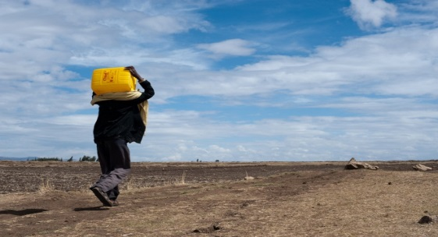
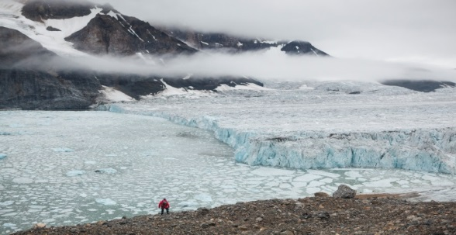
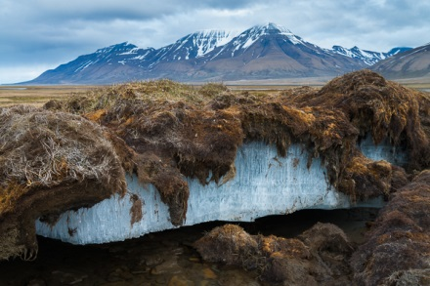
International Hydrological Programme PHASE VIII, 2014-2021
Thank you!
www.unesco.org/water

