Slide 1
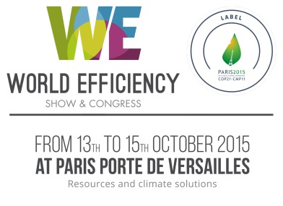
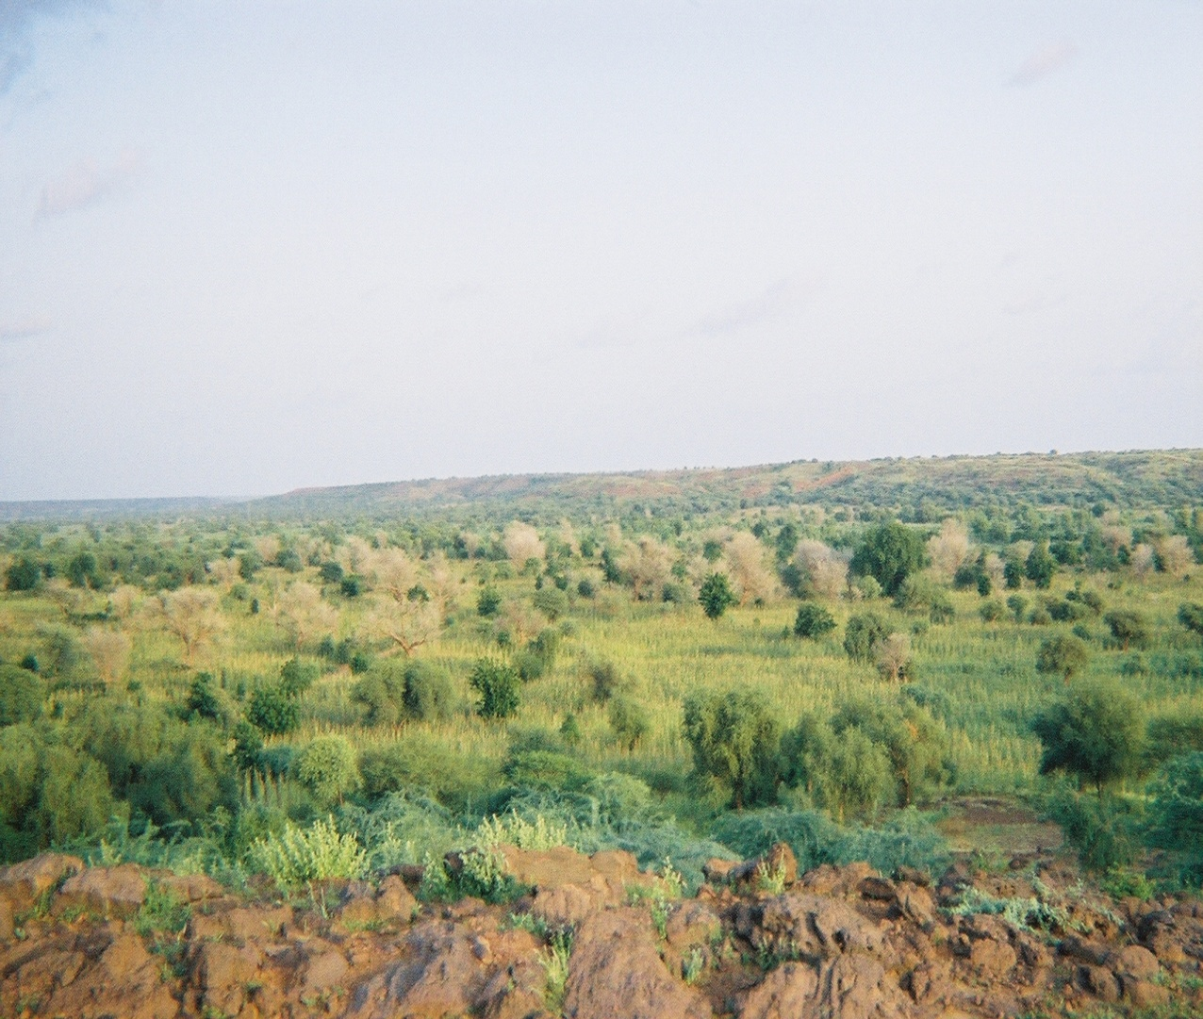
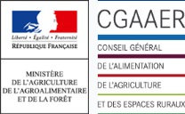



CLIMATE CHANGE, WATER, AGRICULTURE AND FOOD SECURITY:
SETTING THE STAGE
Craig Hanson
Global Director (Food, Forests & Water)
World Resources Institute

Slide 2
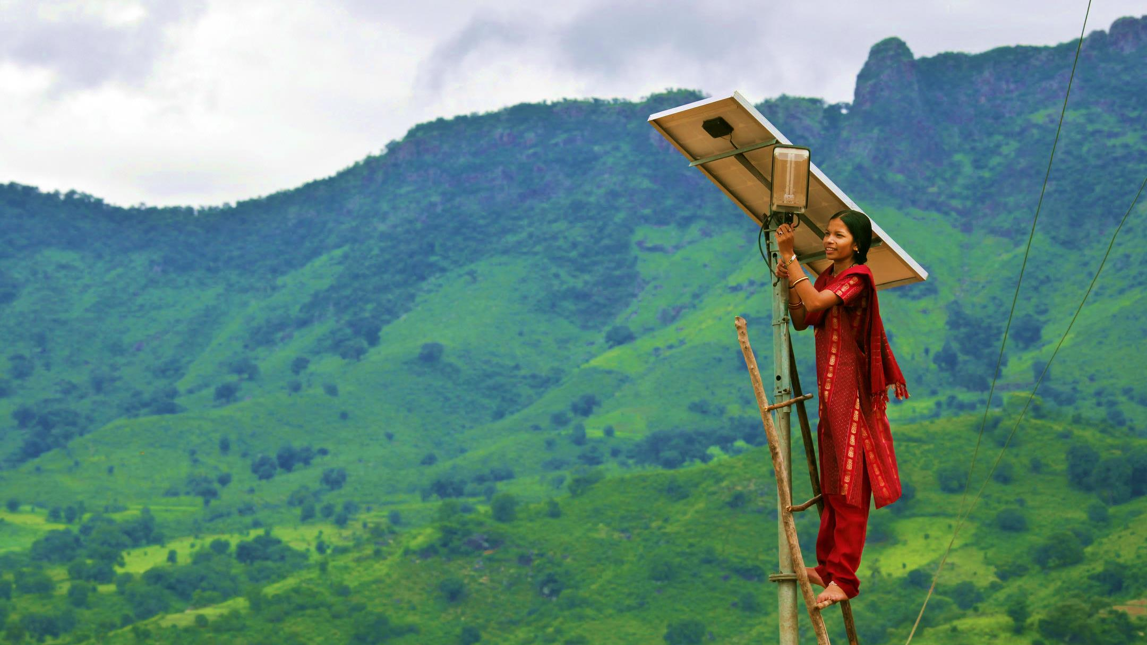
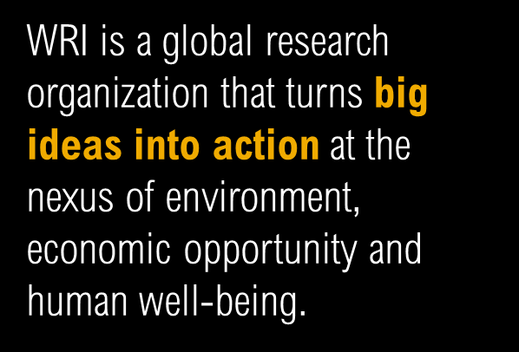

Slide 3
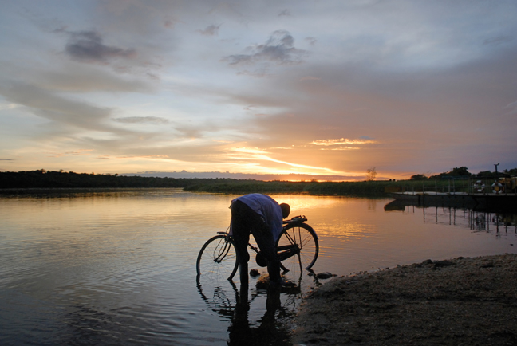


Slide 4
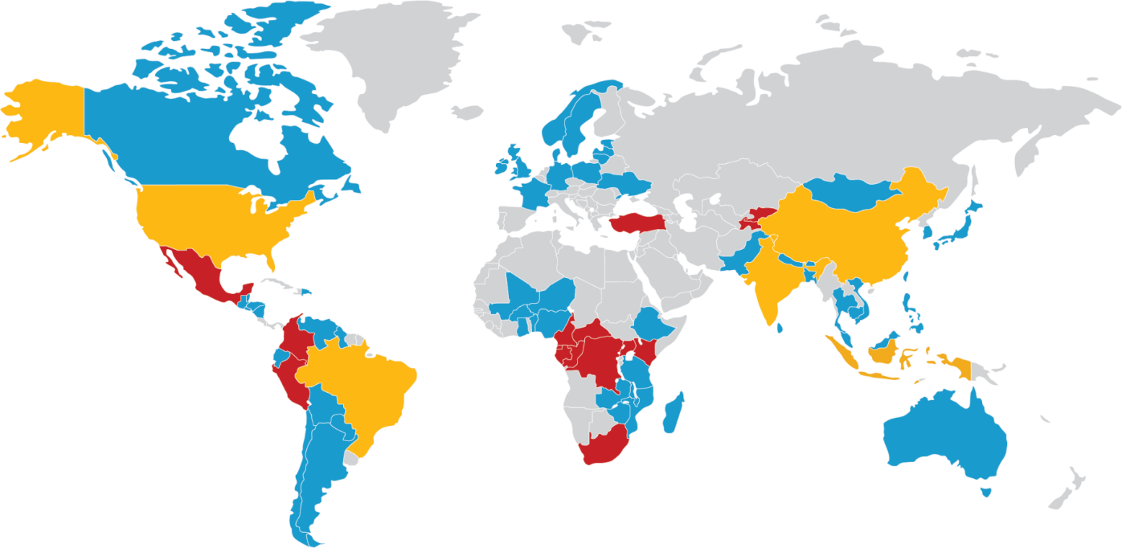
WRI’S GLOBAL NETWORK
Institutional
Project staff on the ground
Active partnership

Slide 5
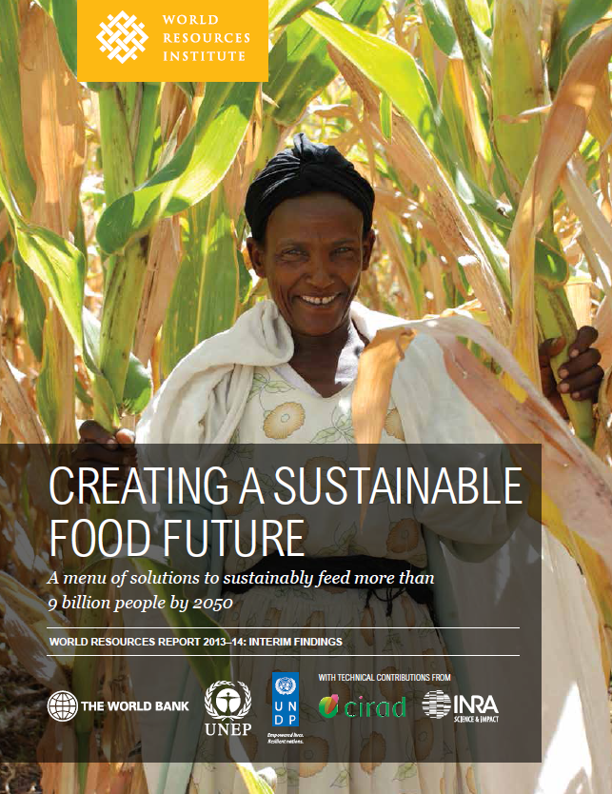
WORLD RESOURCES REPORT

Slide 6
THE GREAT BALANCING ACT
HOW CAN THE WORLD FEED MORE THAN
9 BILLION PEOPLE IN 2050 IN A MANNER THAT ADVANCES DEVELOPMENT AND REDUCES PRESSURE ON THE ENVIRONMENT?

Slide 7
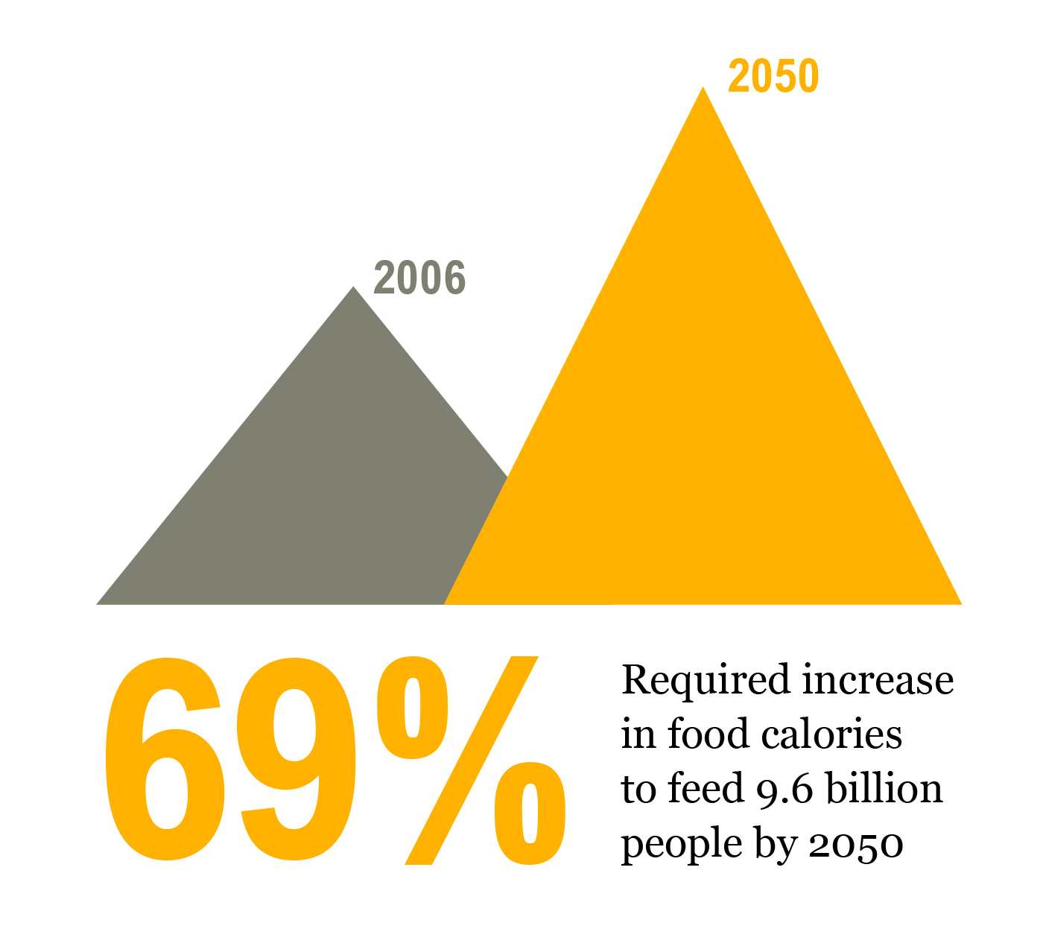
THE WORLD NEEDS TO CLOSE A FOOD GAP
Source: WRI analysis based on Alexandratos, N., and J. Bruinsma. 2012. World agriculture towards 2030/2050: The 2012 revision. Rome: FAO.

Slide 8
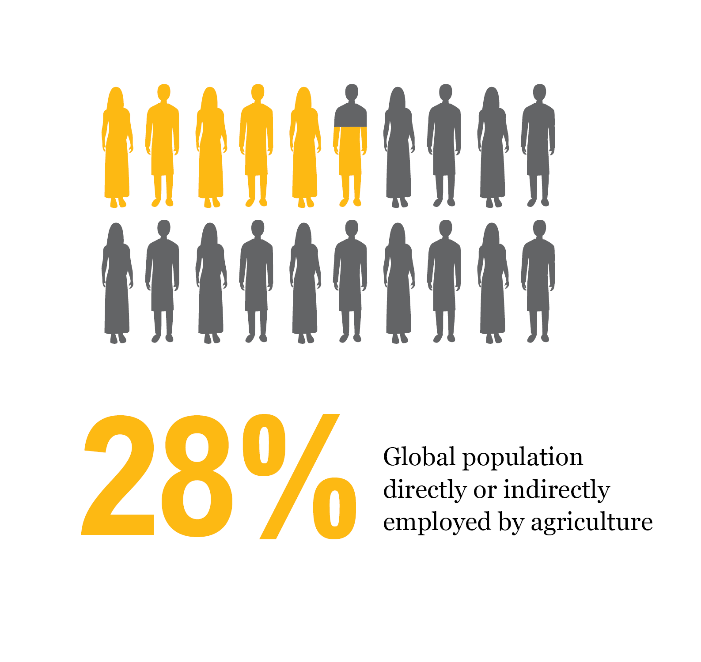
THE WORLD NEEDS AGRICULTURE TO SUPPORT ECONOMIC DEVELOPMENT
Source: World Bank. 2012. World Development Indicators. Accessible at: <http://databank.worldbank.org/Data/Home.aspx> (accessed December 13, 2012).

Slide 9
THE WORLD NEEDS TO REDUCE AGRICULTURE’S FOOTPRINT
Share of global impact (percent in 2010)
GREENHOUSE GAS EMISSIONS
EARTH’S LANDMASS (EX-ANTARCTICA)
WATER WITHDRAWAL
100% = 49 Gt CO₂e
100% = 13.3 bn ha
100% = 3862 km³ H₂O
Source: WRI analysis based on IEA (2012); EIA (2012); EPA (2012); Houghton (2008); FAO (2011); FAO (2012); Foley et al. (2005).

Slide 10
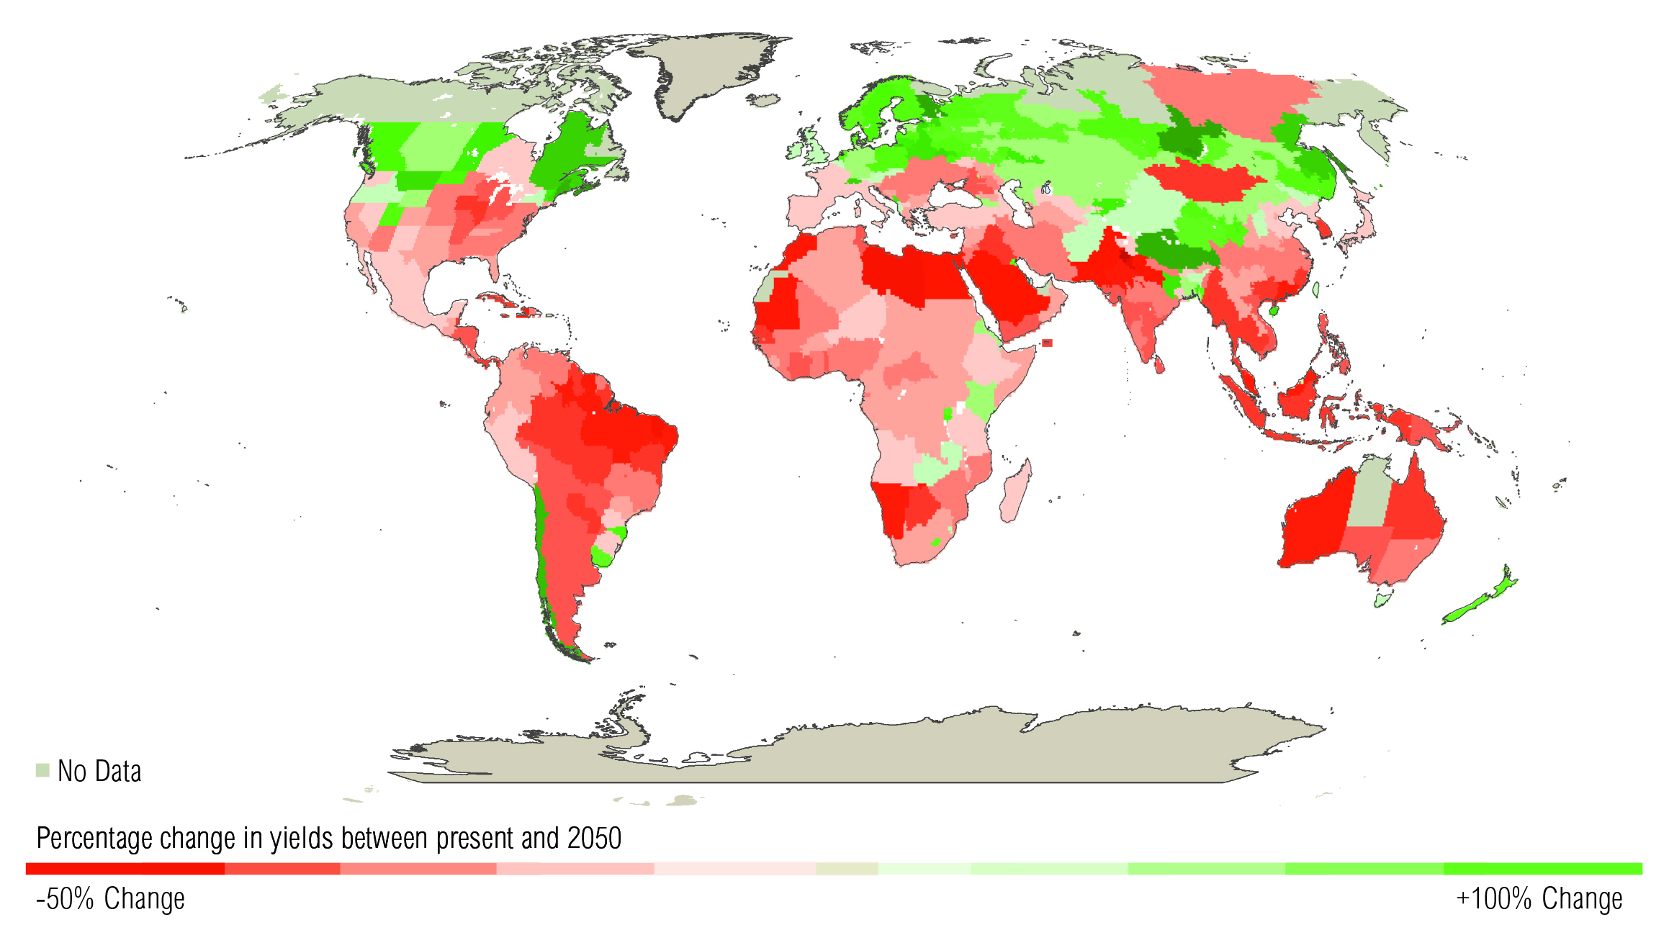
MOST STUDIES PROJECT NET ADVERSE IMPACTS OF CLIMATE CHANGE ON CROP YIELDS (3° C warmer world)
Source: World Bank. 2010. World Development Report 2010: Development and Climate Change. Washington, DC: World Bank.

Slide 11
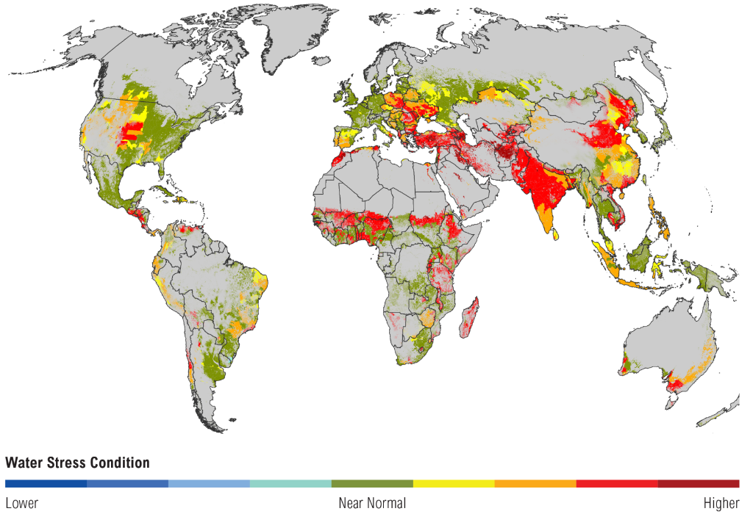
WATER STRESS WILL INCREASE IN MANY AGRICULTURAL AREAS BY 2025 DUE TO GROWING WATER USE AND HIGHER TEMPERATURES
(Based on IPCC Scenario A1B)
Note: Areas in gray contain no croplands.
Source: World Resources Institute’s Aqueduct water mapping system. Crop areas from Ramankutty, N., A. T. Evan, C. Monfreda, and J. A. Foley. 2008. “Farming the planet: 1. Geographic distribution of global agricultural lands in the year 2000.” Glob. Biogeochem. Cycles 22: GB1003, doi:1010.1029/2007GB002952.

Slide 12
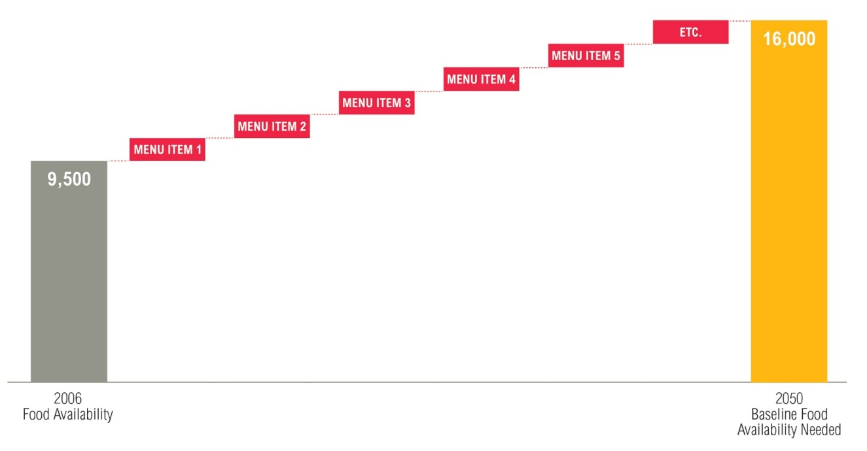
A MENU OF SOLUTIONS IS NEEDED TO SUSTAINABLY CLOSE THE FOOD GAP
Global annual crop production (kcal trillion)*
CONCEPTUAL
* Includes all crops intended for direct human consumption, animal feed, industrial uses, seeds, and biofuels
Source: WRI analysis based on Bruinsma, J. 2009. The Resource Outlook to 2050: By how much do land, water and crop yields need to increase by 2050? Rome: FAO; Alexandratos, N., and J. Bruinsma. 2012. World agriculture towards 2030/2050: The 2012 revision. Rome: FAO.

Slide 13
MENU FOR A SUSTAINABLE FOOD FUTURE
Consumption | Reduce food loss and waste Shift to healthier diets Help achieve replacement level fertility Reduce biofuel demand for food crops
Production | Sustainably increase crop yields Boost yields through crop breeding Improve soil and water management Expand onto low-opportunity-cost degraded lands Sustainably increase “livestock” productivity Increase productivity of pasture and grazing lands Reduce then stabilize wild fish catch Increase productivity of aquaculture
Production methods | Improve livestock feeding efficiency Increase the efficiency of fertilizer use Manage rice paddies to reduce emissions

Slide 14
MENU FOR A SUSTAINABLE FOOD FUTURE
Consumption | Reduce food loss and waste Shift to healthier diets Help achieve replacement level fertility Reduce biofuel demand for food crops
Production | Sustainably increase crop yields Boost yields through crop breeding Improve soil and water management Expand onto low-opportunity-cost degraded lands Sustainably increase “livestock” productivity Increase productivity of pasture and grazing lands Reduce then stabilize wild fish catch Increase productivity of aquaculture
Production methods | Improve livestock feeding efficiency Increase the efficiency of fertilizer use Manage rice paddies to reduce emissions

Slide 15
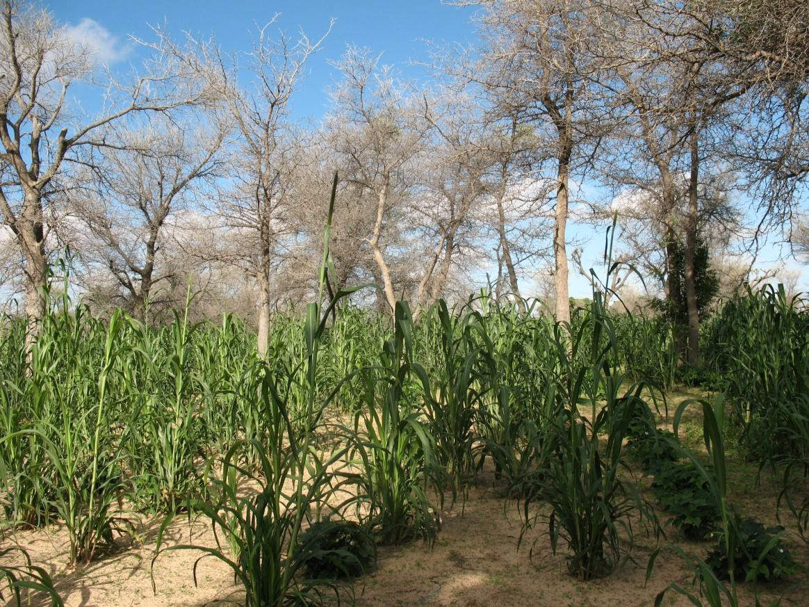
AGROFORESTRY

Slide 16
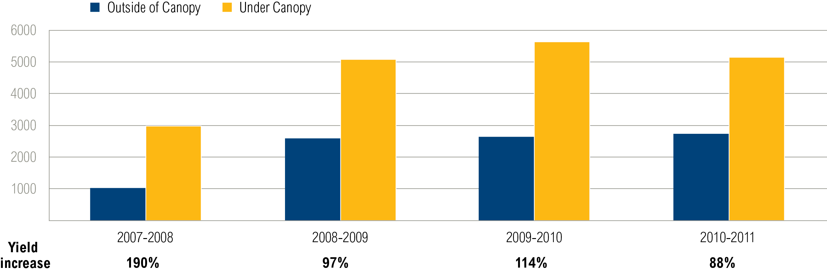
MAIZE YIELDS IN ZAMBIA ARE HIGHER UNDER FAIDHERBIA TREES
Kilograms per hectare
Note: Average maize grain yields from trial sites under and outside canopies of mature Faidherbia albida trees across regions in Zambia.
Source: Shitumbanuma, V. 2012. “Analyses of Crop Trials Under Faidherbia albida.” Lusaka, Zambia: Conservation Farming Unit, University of Zambia.

Slide 17
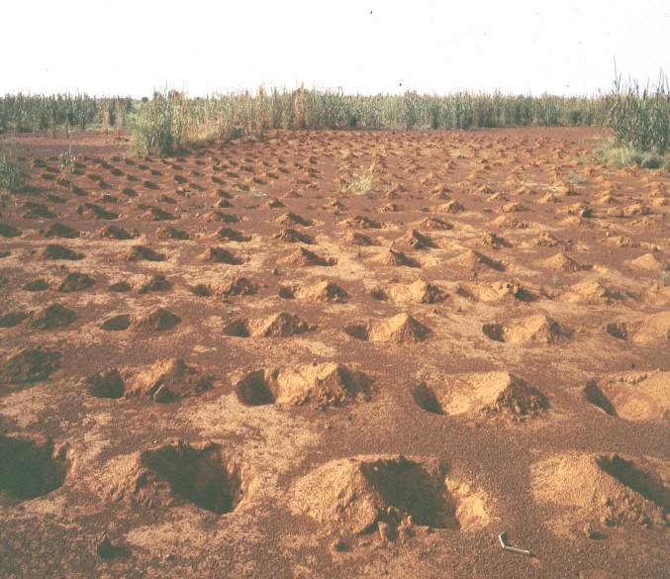
WATER HARVESTING

Slide 18
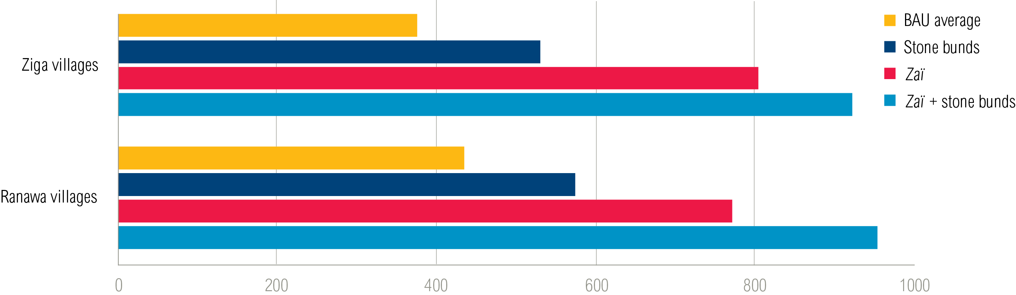
WATER HARVESTING PRACTICES INCREASE YIELD GAINS (BURKINA FASO)
Kilograms per hectare
Note: These two groups of villages are located on the northern central plateau of Burkina Faso. “BAU” = business as usual.
Source: Sawadogo, H. 2008. Impact des aménagements de conservation des eaux et des sols sur les systèmes de production, les rendements et la fertilité des sols au Nord du Plateau Central du Burkina Faso. Ouagadougou and Amsterdam: Etude Sahel Burkina Faso, CILDSS and VU University Amsterdam.

Slide 19
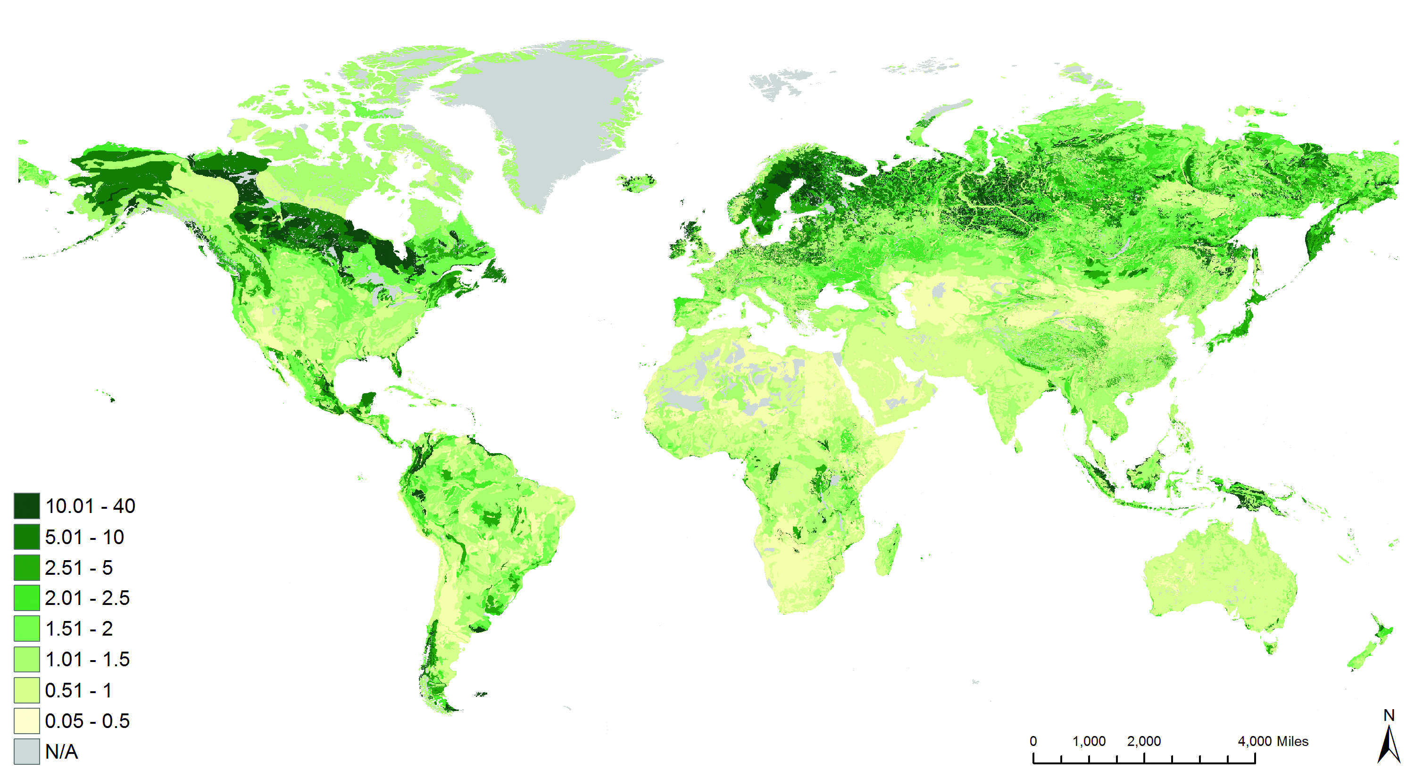
SOIL ORGANIC MATTER CONCENTRATIONS VARY GREATLY
Topsoil organic carbon (percent mass fraction)
Source: Hengl , T., and H. Reuter. 2009. “Topsoil organic carbon based on the HWSD [Data file].” ISRIC World Soil Information. Accessible at: <http://worldgrids.org/duku.php?id=wiki:tochws>. Retrieved May 5, 2013.

Slide 20
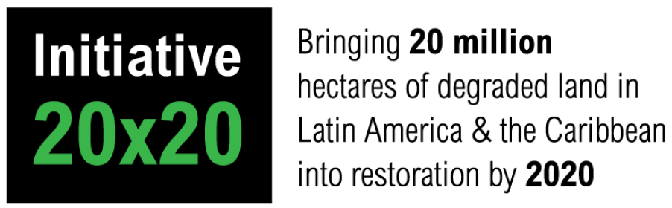
REGIONAL INITIATIVES TO RESTORE DEGRADED LAND: LATIN AMERICA

Slide 21

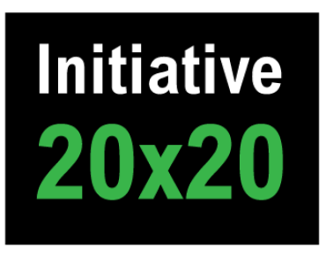



















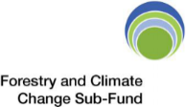

SUPPORT GLOBAL AMBITION
New York Declaration on Forests
TECHNICAL
FINANCE
Costa Rica
Ecuador
El Salvador
Guatemala
Brazil (ES)
Chile
Colombia
Mexico
Nicaragua
Peru
ACHIEVE COUNTRY AMBITIONS

Slide 22


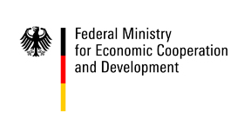

REGIONAL INITIATIVES TO RESTORE DEGRADED LAND: AFRICA
Bring 100 Mha into process of restoration by 2030

Slide 23

Merci beaucoup

