Slide 1
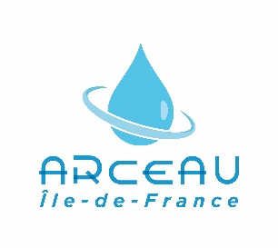


Megacities Alliance for
Water and Climate
Jean-Didier BERTHAULT
Vice President of SIAAP’s Board
Notes:
S

Slide 2
Megacities Alliance for Water and Climate, an initiative of UNESCO and ARCEAU IdF
Megacities Alliance for Water and Climate was launched in Paris during COP21, December the 2nd
  At COP 21 by Irina Bokova, Director-General of UNESCO, during Resilience Day
  At Water, Megacities and Global Change International Conference organised by ARCEAU IdF and UNESCO
Notes:
Une initiative d’ARCEAU IdF : une jeune association de la région parisienne créée en 2013 qui a pour mission de développer les échanges entre chercheurs, opérateurs et décideurs.
Elle veut valoriser le capital de compétences et de savoirs collectés en Ile de France dans la gestion de l’eau à la fois en local pour les acteurs de l’eau mais aussi à l’international.
The SIAAP is one of ARCEAU Founding members

Slide 3
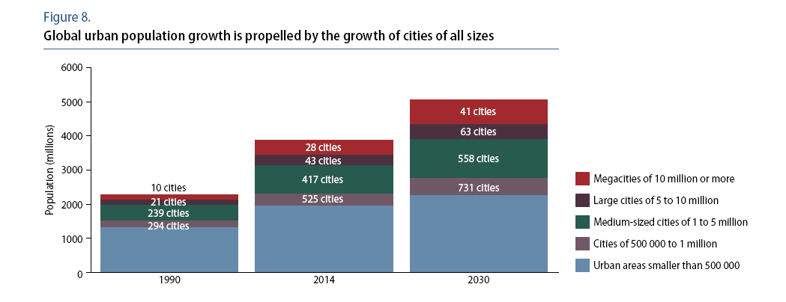
Why a Megacities Alliance in Water ?
Megacities will host more than 1 billion inhabitants in 100 megacities in 2030
60 % of the world’s population will live in urban areas
Source : World Urbanization Prospects UN - 2014

Slide 4
Why a Megacities Alliance in Water ?
Water is one of the major stakes in terms of sustainable development of cities:
  Water resources management
  Water supply and sanitation
  Natural risks: floods and drought
Climate change will strengthen these stakes
All megacities face these problems in different contexts
Megacities has a huge potential in engineering, research, with large operators and many different experiences in governance of water management
A platform for cooperation

Slide 5
The Objectives of the Platform
Collect and disseminate information at a worldwide scale on strategies and operational plans developed by local authorities and their water operators as well as results achieved by their implementation;
Facilitate experience sharing between the academic community and water operators in improving adaptation through best practices assessments;
Identify means and mechanisms for funding the adaptation of Megacities to the impacts of climate change on urban water

Slide 6
The Work is in progress !
June 2016 - the 22nd session of the Intergovernmental Council of International Hydrological Programme (IHP) decided the creation of a Working Group for the establishment of the megacities alliance for water under climate change
  Create an enabling environment for the creation of the Platform and to propose mechanisms for promoting synergies between Megacities (represented by the Platform) at the local level and Member States (represented by the working group) at the national level
ARCEAU is currently implementating a Support Unit that will work for the next two years on the implementation of the Platform, by:
  i) identifying Megacities, raising their awareness about water and climate change and encouraging them to join the network;
  ii) defining the governance model and the terms of reference for the Platform;
  iii) implementing appropriate communication and information tools, including a website;
  and iv) creating and managing a network of stakeholders interested in the Platform.
The publication of a synthesis of Water management in 15 megacities
Notes:
UNESCO decided to establish an IHP Working Group for helping the establishement of the Megacities Alliance for water under climate change; and for proposing mechanisms to promote international synergies between megacities at the local level and Member States at the national level;
ICLEI - Local Governments for Sustainability is the leading global network of over 1,500 cities, towns and regions committed​ to building​ a sustainable future.

Slide 7
The basement of the network
ICLEI, IWA, Mexico, Water links,
Notes:
L’organisation de la conférence Eau et Mégapole (Eaumega 2015) a donné lieu à la préparation de 15 monographies dont une synthèse a été produite par ARCEAU et l’UNESCO. Ce travail est aussi la base du réseau sur lequel nous comptons nous appuyer pour avancer.

Slide 8
Notes:
une plaquette disponible en salle et un livre qui sera officiellement présenté à Quito lors de HABITAT III

Slide 9
The next steps
September : Climate Chance in Nantes (FR), presentation of the Alliance
October :
  Megacities Alliance will be at HABITAT III in Quito. Presentation of the portraits of 15 megacities and of the Alliance
  Water Links meeting in Manilla about platform organisation
7-18 November : COP22
2017: The action year for the UNESCO’s Working Group and ARCEAU’s Support Unit
2018: First meeting of the platform and Second Water, Megacities and Global Change Conference
Notes:
En Conclusion : Le SIAAP s’intéresse à cette initiative parce qu’il épure les eaux de la mégapole parisienne.
Il a une grande expérience à partager sur le plan technique, industriel et de la collaboration avec le monde de la recherche.
Il a aussi beaucoup à apprendre de ses pairs notamment dans la gestion de l’eau comme ressource car il est convaincu que cette question des ressources contenues dans les eaux résiduaires est majeure pour l’atténuation du changement climatique, pour les liens entre assainissement, énergie et alimentation.
Il est aussi convaincu qu’il peut trouver de l’inspiration sur les partenariats entre déchets liquides et solides.

